Slide 1
Newcastle University
Pre-Departure Event for Offer Holders
starting soon…

Slide 2
Content of today’s session:
Welcome to Newcastle!
Accepting your offer
Visa process
Accommodation
Important Dates, Registration, preparation before you travel
Student Life and Student Support Services
Careers
Newcastle Global Contact
Notes:
IO edit once know order

Slide 3
Housekeeping...
Do not share any personal details in the chat or Q&A as they will be visible to everyone
Do not turn on your microphone or ask questions verbally – only ask in the chat please
If you have questions, post them in the Q&A function for the relevant teams throughout the presentation
Avoid asking the same questions
Today’s PPT Slides will be emailed to you
***Individual application queries posted in the Q&A can not be addressed, all students with question about individual application should email: international.recruitment@ncl.ac.uk
Notes:
IO edit once know order

Slide 4
Outstanding global reputation.
A Global Top 140 University
Top 10 UK University for Sport
BUCS League Rankings
QS World University Rankings 2026
  Founding member of the Russell Group alongside Oxford, Cambridge and 21 other leading UK Universities
Notes:
Edit ranking
New figure for UK uni

Slide 5
Outstanding global reputation.
No.1 Best Student City in the UK
University Compare 2026
95% of our graduates are in work or further study after 6 months
DLHE
Top 90 in the World for Employer Reputation
QS World University Rankings 2024
Notes:
BLANK SLIDE
To duplicate slide, select copy on tool bar and then duplicate on drop down menu.

Slide 6
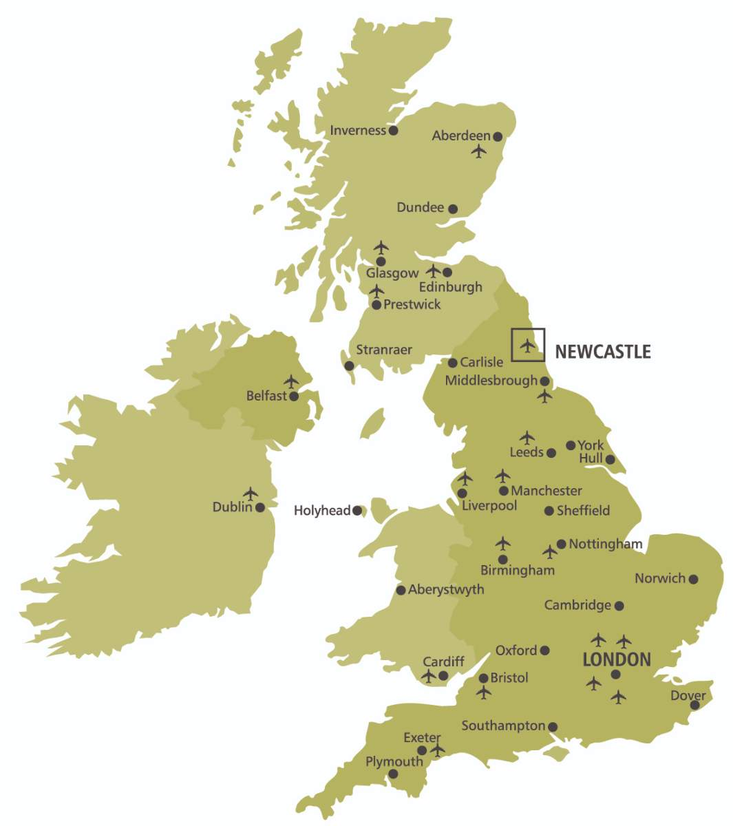
Our Location
Newcastle International Airport (20 mins from our central campus)
Transit from London, Dubai, Amsterdam or Paris
3 hours by train from London
  And great rail connections across the UK!

Slide 7
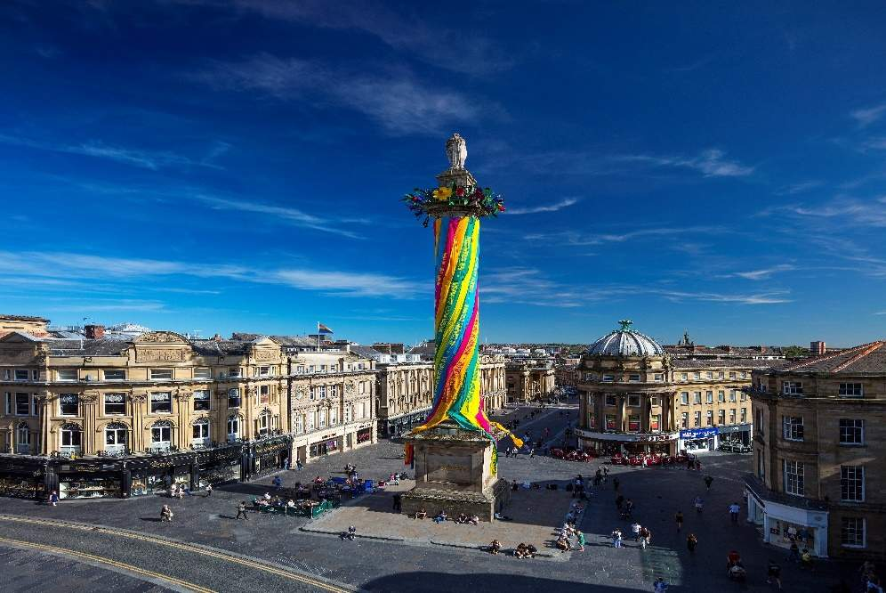
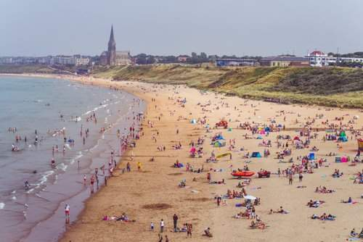
Newcastle City Life
One of the safest and friendliest cities in England
Population of over 300,000
Student discounts available all over the city
Lively, with lots of activities, yet still compact
Walkable, but with good local bus and Metro options
One of the driest cities in the UK, but windy!
Close to nature, beaches & historical architecture:
More castles and historic battle sites than any other region in England
Hub for innovation and enterprise: Largest AI data centre in Europe, Nissan, Accenture, Sage, Ubisoft, Atom Bank, Crown Works.
Home to countless bars & restaurants, multiple art galleries and theatres, cinemas, parks, music festivals, sporting events...
Notes:
New figures
Nre images

Slide 8


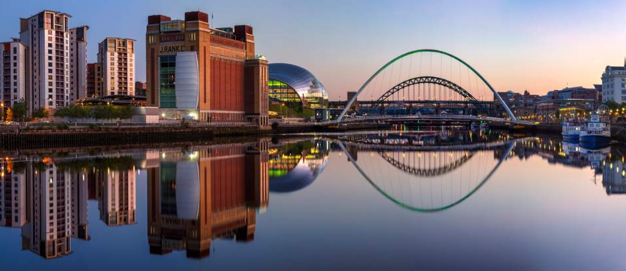

Notes:
7 different bridges, markets, free museums

Slide 9





Notes:
Georgian streets and architecture

Slide 10
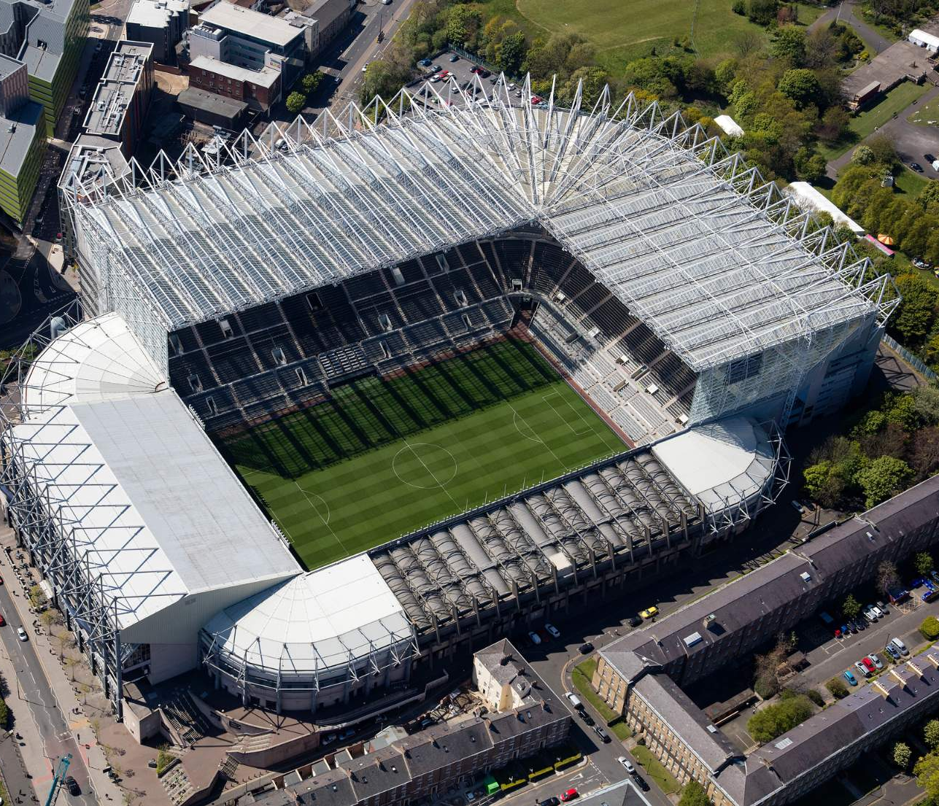
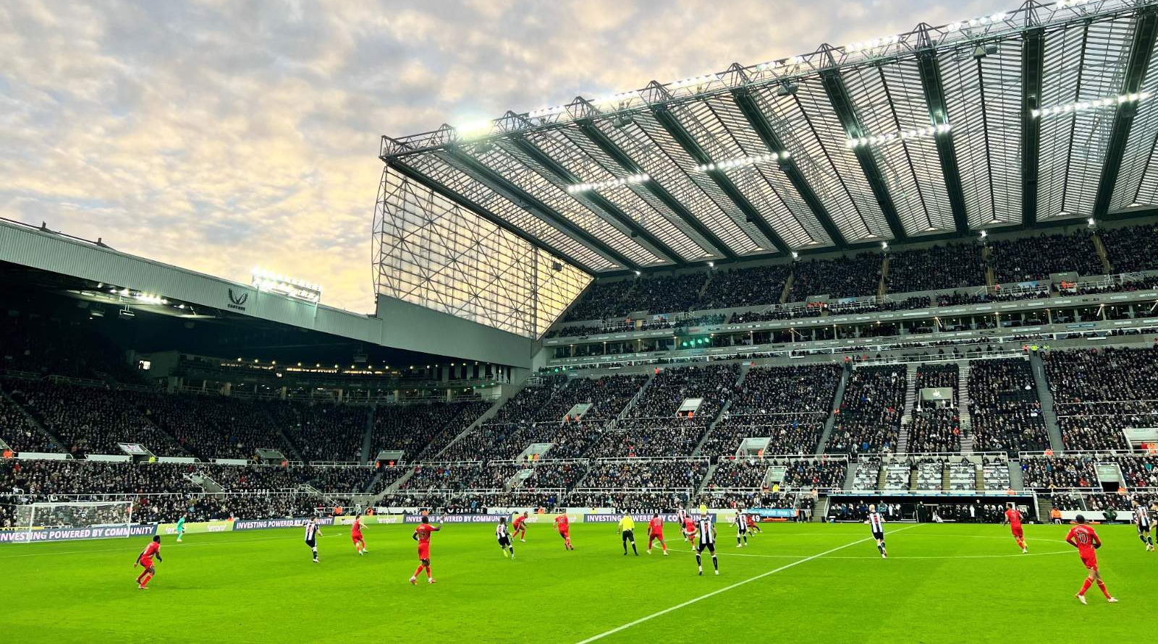

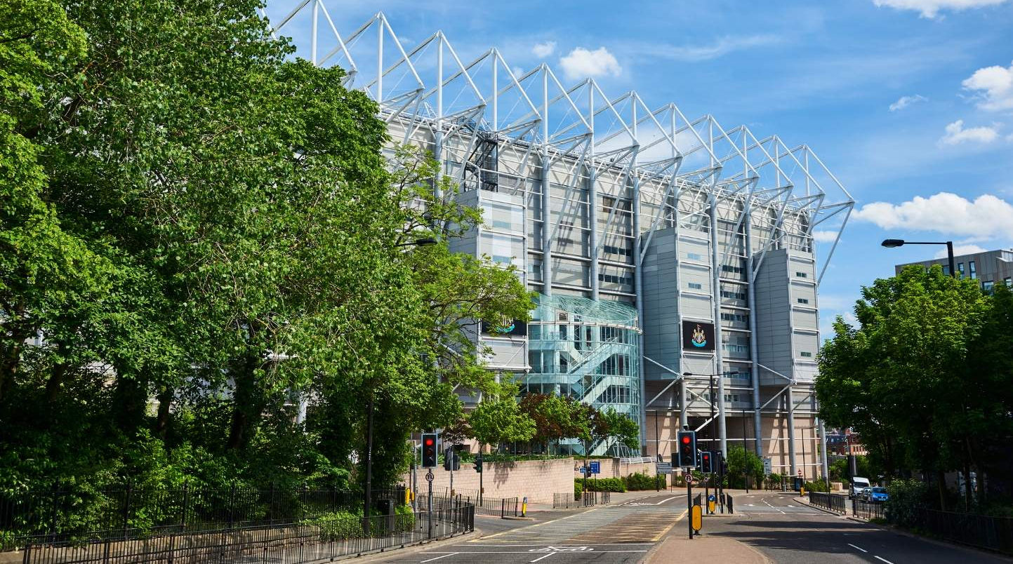
Notes:
St James Park

Slide 11
City centre campus

Slide 12
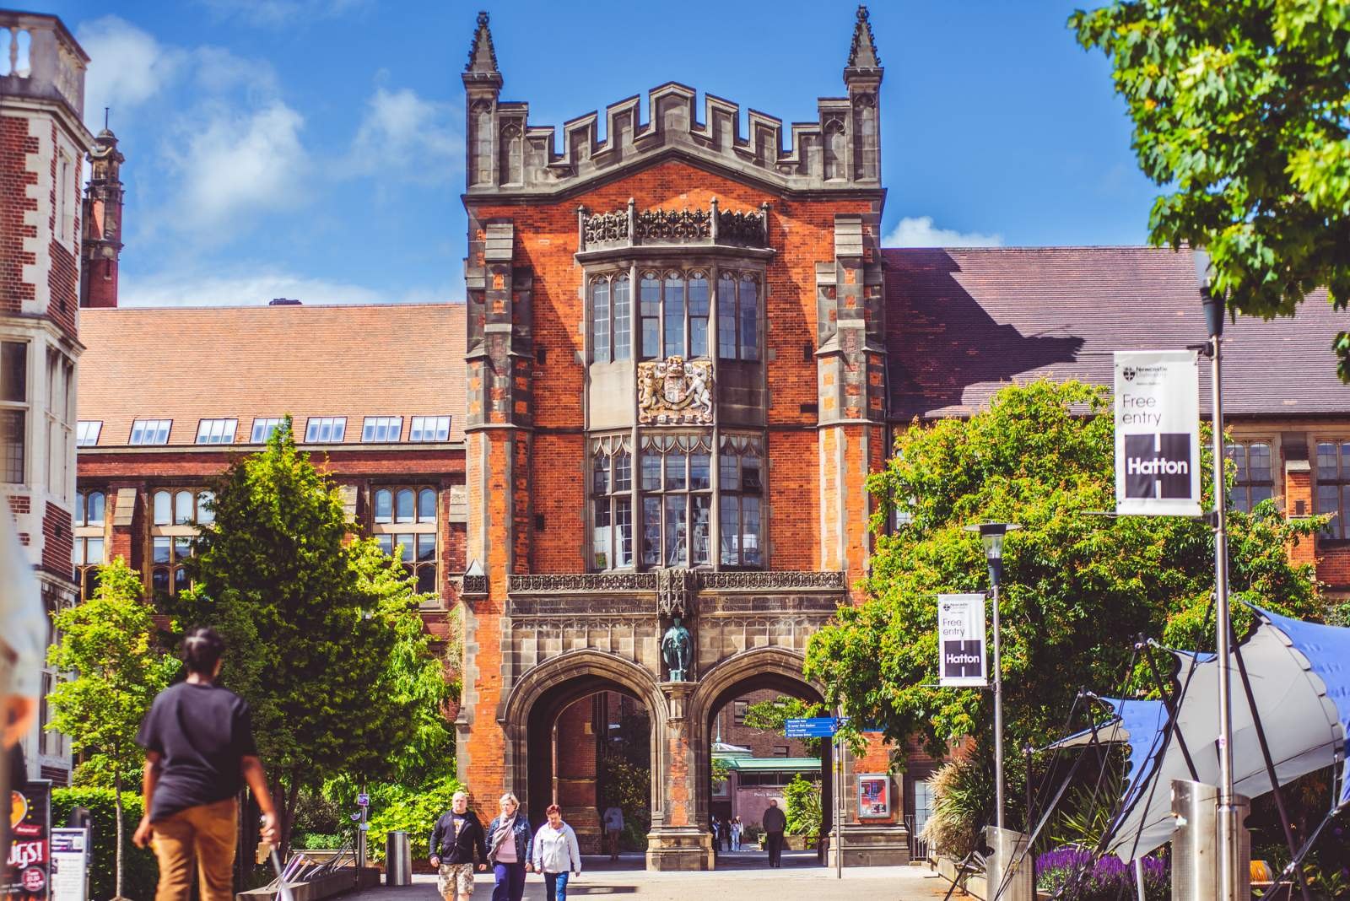
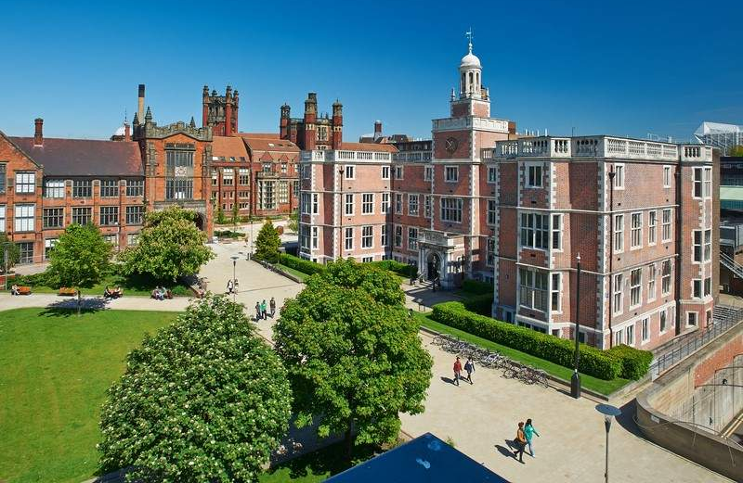
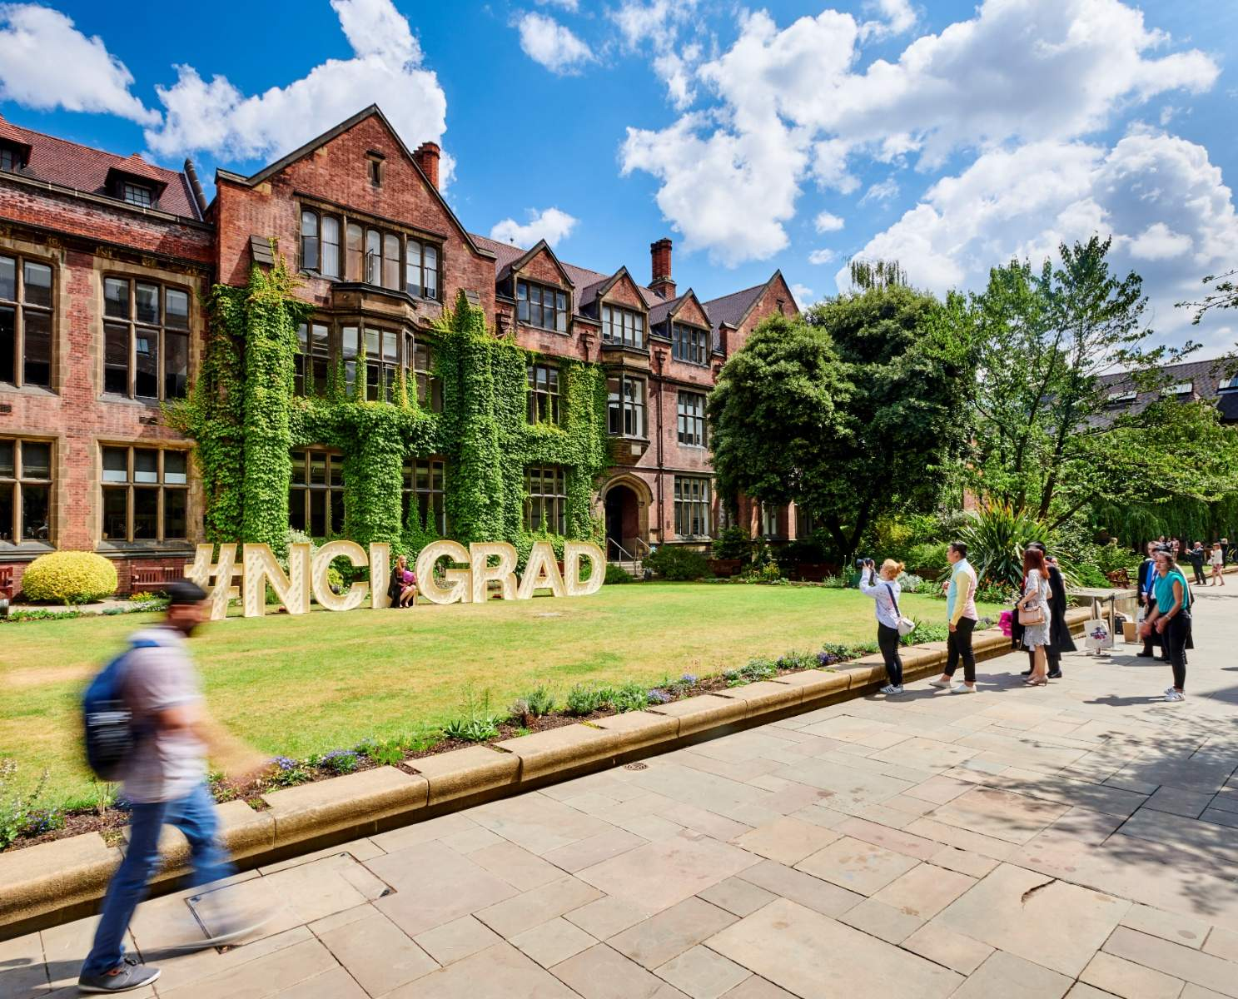

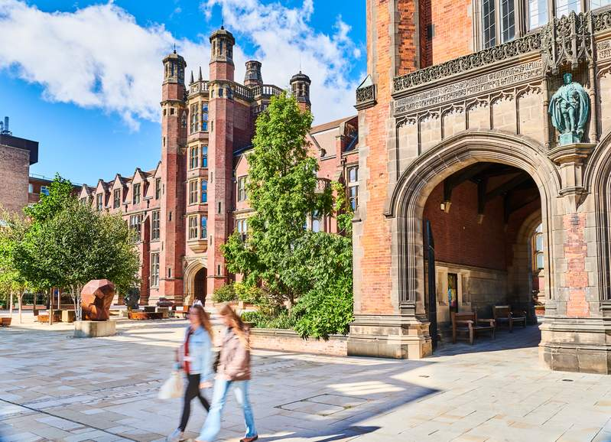

Slide 13
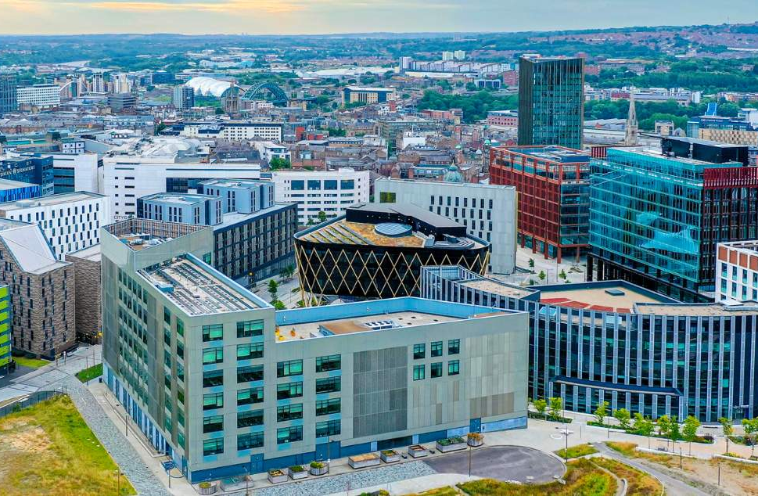
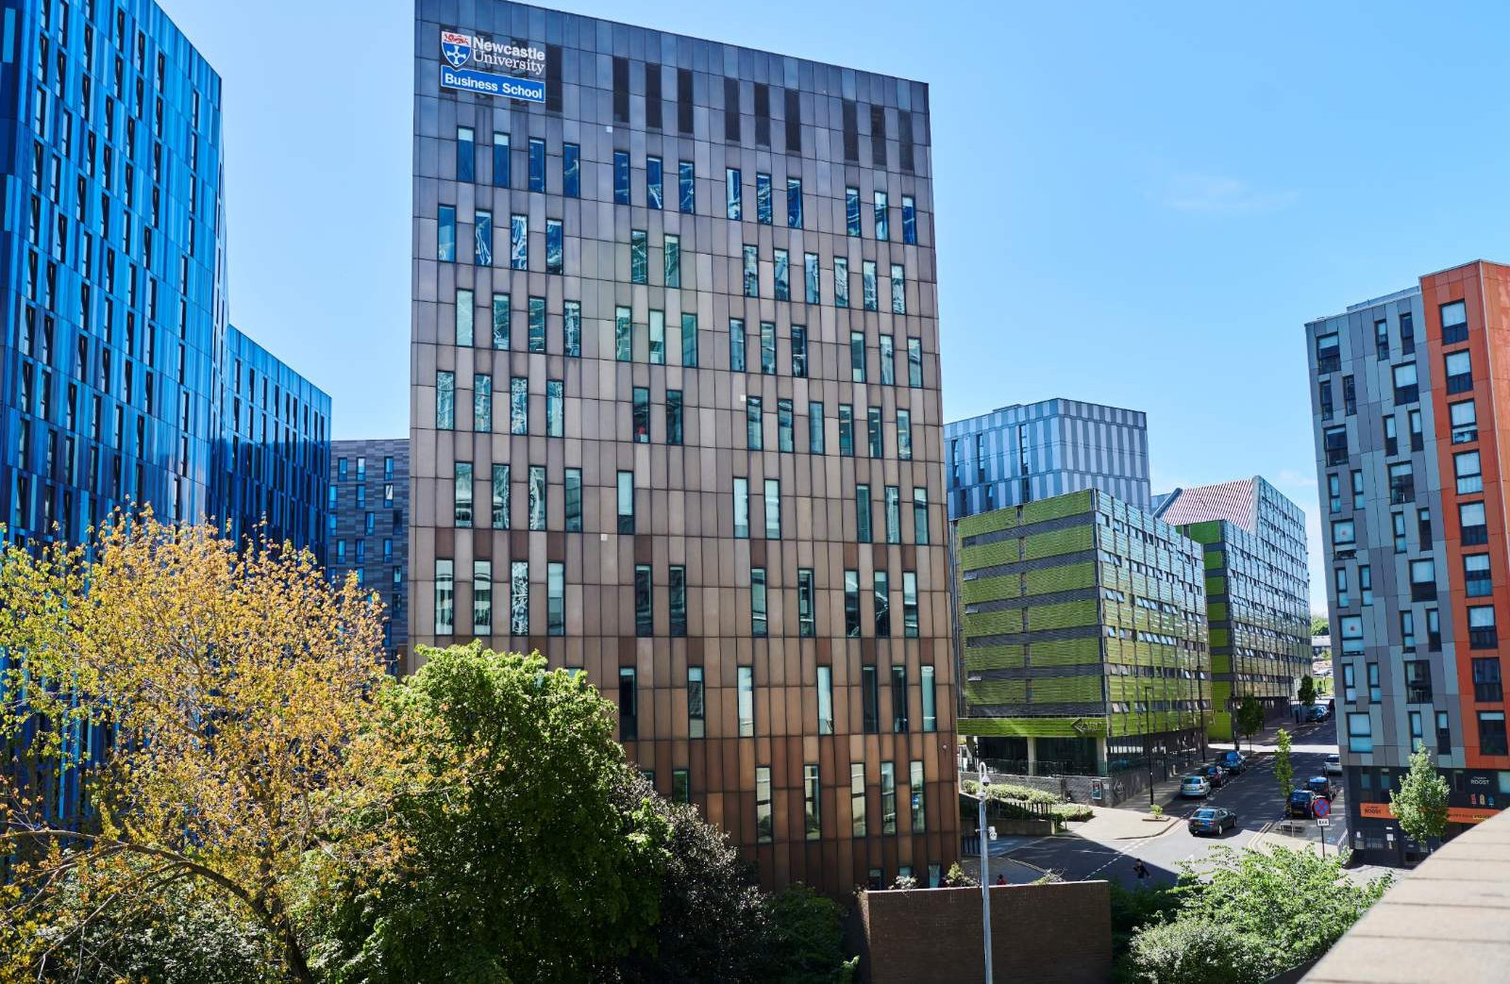
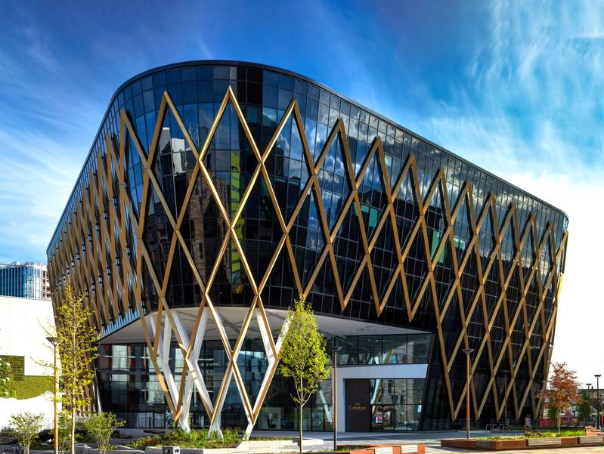
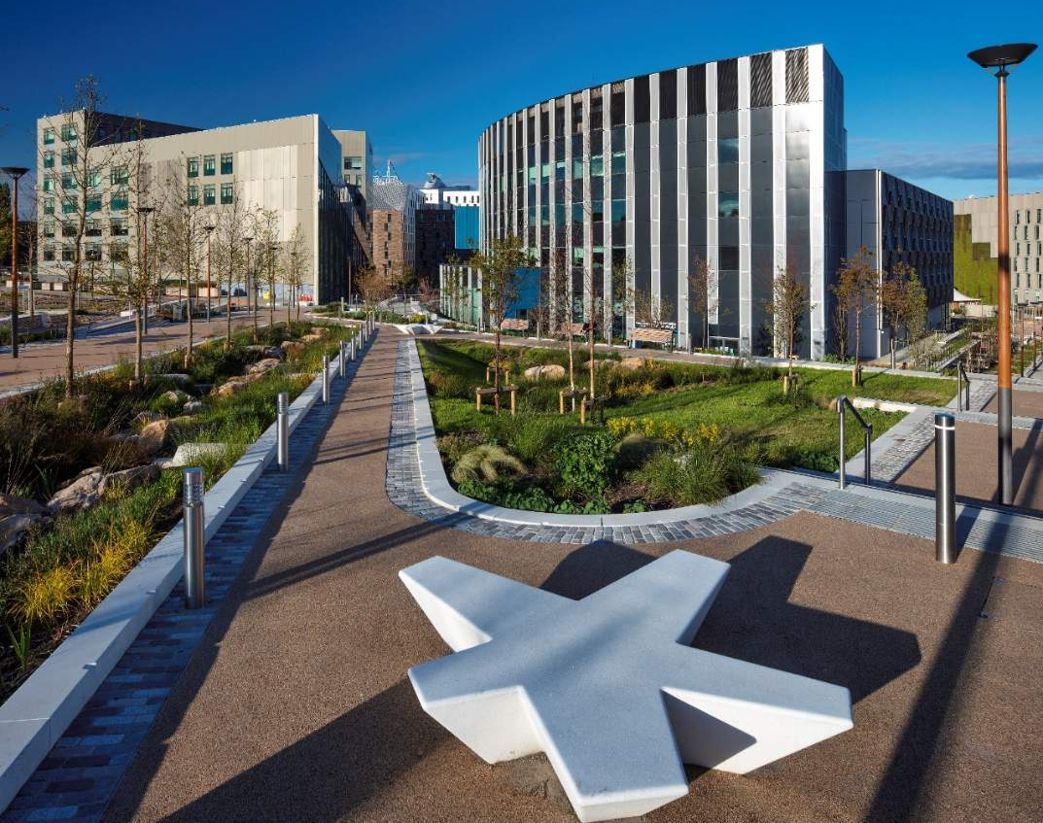
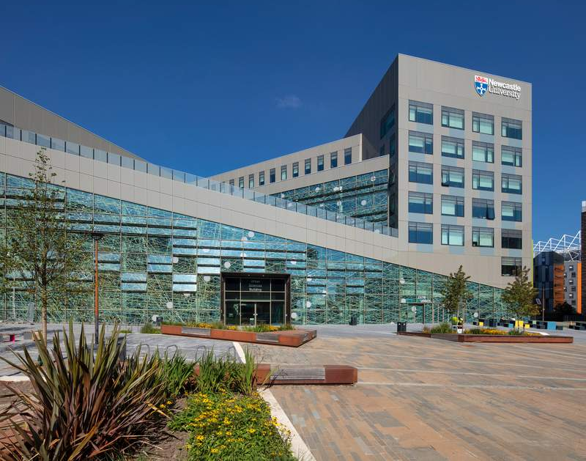
Notes:
A landmark $500 million hybrid city quarter in the centre of Newcastle, built for the University, international tech and science businesses, the local community and residents.

Slide 14
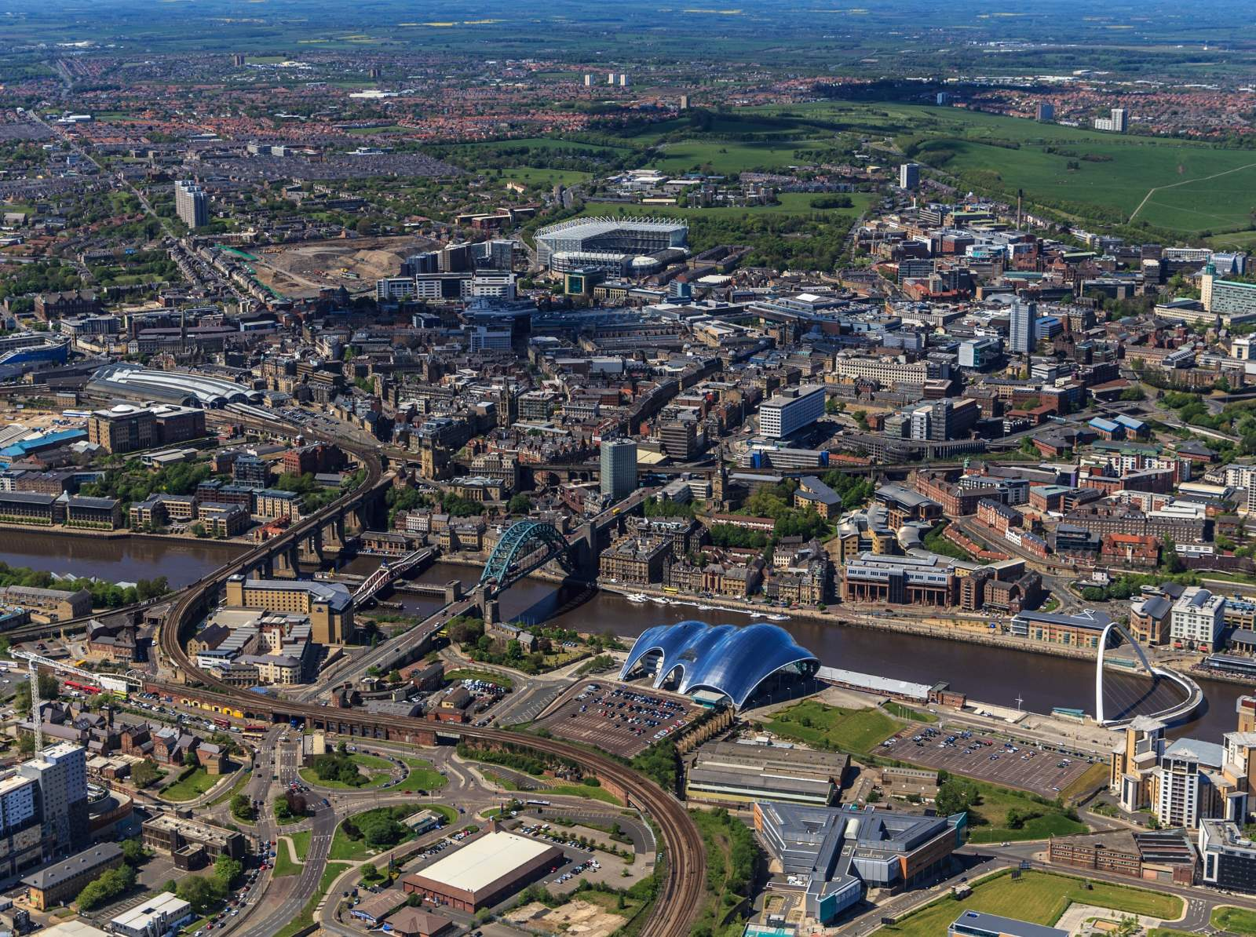
St James’ Park football stadium
Business School +
School of Computer Science
Main Campus
Central Railway
Station
Chinatown
Tyne Bridge
The Glasshouse Gateshead
Millennium
Bridge

Slide 15
Admissions
Notes:
FIXED Image / Presentation title slide.
Insert title and sub-deck as required to start your presentation.
`1234567890-=qwertyuiop[]asdfghjkl;’#\zxcvbnm,./
¬!”£$%^&*()_+QWERTYUIOP{}ASDFGHJKL:@~|ZXCVBNM<>?

Slide 16
Undergraduate students
Accepting your offer
Step 1: Accept your offer in UCAS
Step 2: You’ll need to meet all conditions on your offer so please upload all the exam results we have asked for as well as your English Language test result
Step 3: The University will be in touch with you to request a copy of your passport and once this has been received your CAS is issued.
Please note that a CAS can't be used to apply for a Student Visa more than 6 months before the start date of your course.
Notes:
As soon as you meet ANY of your conditions, notify the
University by uploading your documents.

Slide 17
Postgraduate students
Accepting your offer
Step 1: You'll need to have accepted your postgraduate offer. If you have more than one offer, please make sure you decline the other offers that you do not wish to accept
Step 2: You need to have met all conditions AND
Step 3: Paid your deposit (or provided formal proof of sponsorship) - minimum of £1,500 (This is for your Confirmation of Place issuance). If there is a deadline for payment, this will be stated in your offer letter
Step 4: We’ll inform you by email when your Confirmation of Place (COP) is available to view in your applicant portal
Notes:
What if I miss my conditions?
Contact the University as soon as possible!
You should also contact PG Admissions if your study plans have changed and you no longer intend to study at Newcastle University this academic year. Approximately 5-7 working days after your COP is issued we will automatically produce your CAS statement.

Slide 18
Postgraduate students
Accepting your offer
Step 5: For all Postgraduate programmes, once your COP has been released, we will then send you an email to confirm your Confirmation of Acceptance of Studies (CAS) is available. You will need to log into your applicant portal to view this document and check all of the information. You can then confirm the details are correct or complete the relevant section to advise us of any changes to be made.
Step 6: Once these details have been confirmed your full CAS letter will be released within 5 working days.

Slide 19
What if I have narrowly missed my conditions or have any queries on my offer?
Accepting your offer
Contact the University as soon as possible – by logging into your portal and sending an enquiry.
Notes:
What if I miss my conditions?
Contact the University as soon as possible!
You should also contact PG Admissions if your study plans have changed and you no longer intend to study at Newcastle University this academic year. Approximately 5-7 working days after your COP is issued we will automatically produce your CAS statement.

Slide 20
VISA
Notes:
FIXED Image / Presentation title slide.
Insert title and sub-deck as required to start your presentation.
`1234567890-=qwertyuiop[]asdfghjkl;’#\zxcvbnm,./
¬!”£$%^&*()_+QWERTYUIOP{}ASDFGHJKL:@~|ZXCVBNM<>?

Slide 21
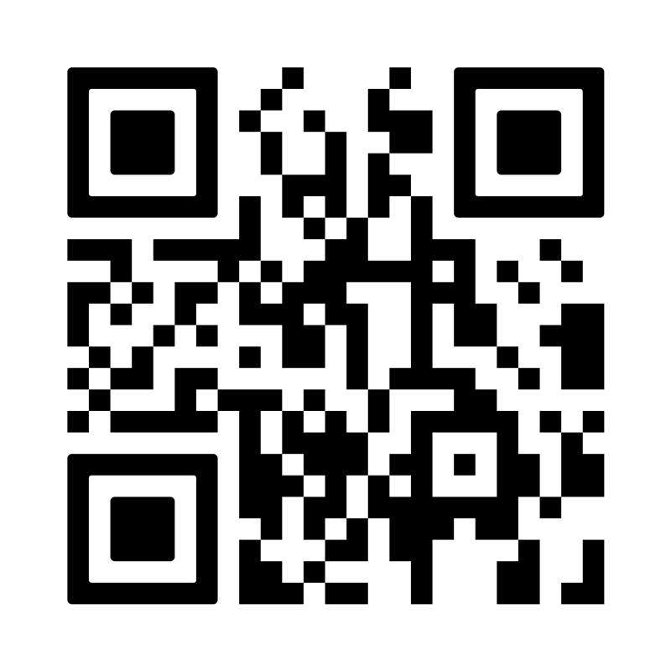
Visa Information
Applying for a UK Visa
Check which visa you need to come to the UK
Apply for visa, if required
Ensure you have the correct supporting documents from the university for the visa application
Make sure your passport is valid for your travel to the UK
How to apply: www.ncl.ac.uk/student-progress/visa/student-route-visa/
Visa Support website and contact information
University Visa Team webpage www.ncl.ac.uk/visa
Email visa@ncl.ac.uk
www,ncl.ac.uk/visa

Slide 22
Student Visa Application Guide
Receive CAS (Student Visa) or Visa Letter (Standard Visitor Visa)
Prepare supporting documents for visa application
Apply for Student Visa & attend biometric appointment
Wait 3-5 weeks for visa to process
Receive visa decision by email
Access your eVisa and link your passport
Travel to the UK (after the start date of you visa)
Tips for making a visa application:
Prepare all the required supporting documents which meet the Student Visa requirement
Apply for the visa as soon as you can
Book biometric appointment as soon as possible
Ensure your bank or financial sponsor has unconditional consent to confirm your details to the UKVI
Contact us if no update from UKVI after around 5 weeks from date of biometric appointment

Slide 23
Travelling to the UK on your eVisa
When visa is granted, you will receive email notifying you of the duration of the visa
Please check the dates on the email/letter – this should cover the dates of your programme
Follow the instructions on the decision email to create an eVisa and link it to your passport
In all cases, please follow the steps to access your eVisa and link your passport to the eVisa
You must not travel to the UK before the start date of the visa
Further information:
www.ncl.ac.uk/student-progress/visa/evisa/
www.gov.uk/study-uk-student-visa

Slide 24
Graduate Route
The Graduate Route (or ‘post-study work’) visa offers students the opportunity to apply to stay in the UK after their studies.
Undergraduate and Postgraduate Taught students will be able to apply to remain for 18 months.
Postgraduate Research students will be able to apply to stay for 3 years.
For further information and future updates on the Graduate Route see
www.ncl.ac.uk/student-progress/visa/working-in-uk/graduate-route/

Slide 25
Tuition Fee Payment
Convera
Notes:
FIXED Image / Presentation title slide.
Insert title and sub-deck as required to start your presentation.
`1234567890-=qwertyuiop[]asdfghjkl;’#\zxcvbnm,./
¬!”£$%^&*()_+QWERTYUIOP{}ASDFGHJKL:@~|ZXCVBNM<>?

Slide 26
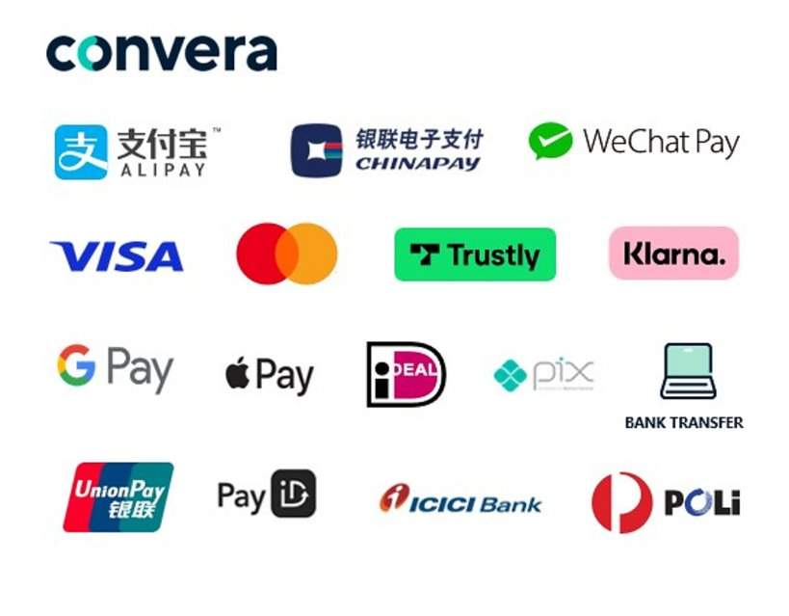






students.convera.com/newcastle#!/
You or your family member access Convera GlobalPay for Students​
Receive payment instructions and reference number​
Pay Convera GlobalPay for Students in your home currency​
Convera will send your funds to Newcastle University​
Newcastle receive funds and mark your account as
paid​
Get a quote and choose payment method​
Track
Payment
status
students.convera.com/#!/tracking ​
Pay in your local currency using payment local payment options
Price promise guarantee for local bank transfer methods
Convera will not charge any fees
Dedicated support throughout the payment journey students.convera.com/#!/contact-us
Multilingual platform (supporting ten languages)
Desktop and Mobile compatible

Slide 27







How it works
Your Home Country
You or your parent access Convera GlobalPay for Students
Benefits
Pay in your local currency
Local payment options
Price promise
No fees
Dedicated Student Support
Real-time payment & refund tracking
Multilingual platform (supporting ten languages)
Desktop and Mobile compatible
Get a quote and choose payment method
Receive payment instructions and reference number
Pay Convera GlobalPay for Students in your home currency
Bank
Online
Convera GlobalPay for Students banking network
Convera will send your funds to Newcastle University
Track Payment status: students.convera.com/#!/tracking
Newcastle University
Newcastle receive funds and mark your account as paid
Notes:
Avoid costly transaction changes from your bank by using a variety of familiar payment options, including bank transfer, credit, or debit card, or eWallet, ensuring your payment arrives on time and in full
Compare payment options provided by Convera and lock-in rates for 72 hours* (about three days)
Price promise guarantee - if you find a cheaper quote through your bank that is cheaper than the price offered by Convera, we will honor your bank’s total price for added peace of mind.

Slide 28
Accommodation
Notes:
FIXED Image / Presentation title slide.
Insert title and sub-deck as required to start your presentation.
`1234567890-=qwertyuiop[]asdfghjkl;’#\zxcvbnm,./
¬!”£$%^&*()_+QWERTYUIOP{}ASDFGHJKL:@~|ZXCVBNM<>?

Slide 29
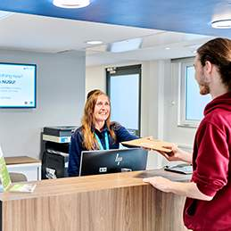
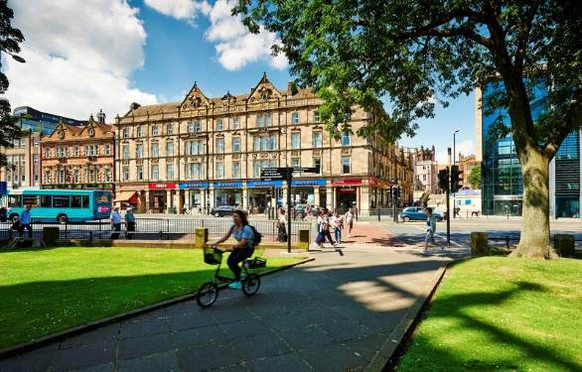
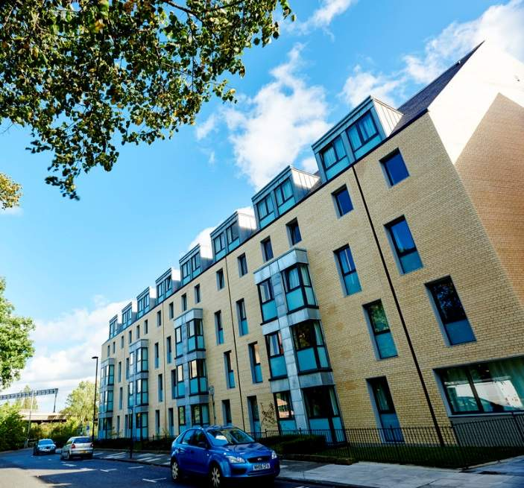
University Accommodation
Notes:
International students are guaranteed a place in university-owned or managed partnership accommodation for their first year of study, provided they meet certain criteria.
Undergraduate Students
Firm offer holders will be given preferential consideration for accommodation
Students should apply online here - https://www.ncl.ac.uk/accommodation/new-students/apply/

Slide 30
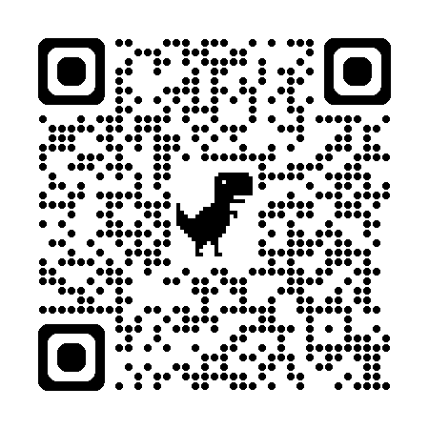
Accommodation
Before You Arrive....
•Let us know your arrival date - We will send you an email asking you to complete your induction which is how you select your arrival slot.
•Complete your induction to generate your key release confirmation – (we’ll ask you to complete your induction approximately 14 days before you arrive). You must complete your induction to generate your Key Collection Pass which you need to collect your keys.
•Plan your journey - Arrival arrangements vary depending on the accommodation you are moving in to. Please ensure that you have referred to the accommodation specific arrival details, which can be found by scanning the QR code.
•Not sure what to bring – check out our suggestions by scanning the QR code.
Notes:
International students are guaranteed a place in university-owned or managed partnership accommodation for their first year of study, provided they meet certain criteria.
Undergraduate Students
Firm offer holders will be given preferential consideration for accommodation
Students should apply online here - https://www.ncl.ac.uk/accommodation/new-students/apply/

Slide 31
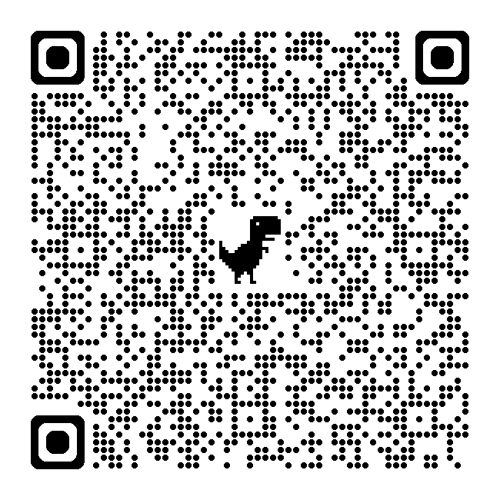
Arriving to University Accommodation
Earliest arrival date for International students is 14 September
Earliest arrival date for UK students is 17 September
Collecting keys from your residence reception
Kensington Terrace and Park View are open Monday – Friday, 8am – 6pm.
Bowsden Court reception is open Monday – Friday, 8am -12 noon.
All sites are open on Saturday 19th September for key collection
Grand Hotel key collection point is at Barras Building, open 24/7.
Collecting keys outside of reception opening hours
If you arrive outside of reception opening hours, you'll need to contact our Security team on +44 (0) 191 208 6817 or via an on site call point. Visit our website to download a PDF with full instructions.
Living in non University owned accommodation
Refer to information sent to you by the private provider in your emails.
Accommodation

Slide 32
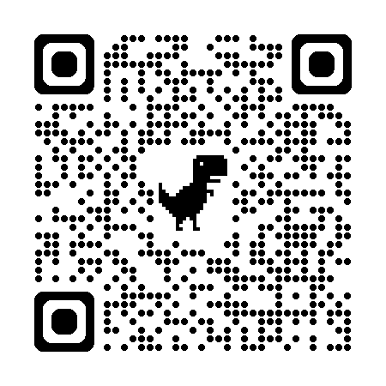
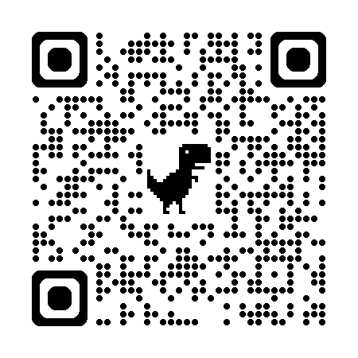
Accommodation
Things to note
You are expected to provide your own bedding, towels, crockery, pans, and cutlery. Our reception team are on hand to direct you to stores where you can buy these items. If you arrive late and do not have bedding, we can provide some for free on a short term loan until you can purchase your own.
This year we are running a project called ResLife ReHome where we give a new home to everyday essentials that our previous students have donated. For more info on when you can check out what there is, scan this QR code.
What to look forward to once you move in
Your ResLife Team – provide a wrap-around programme surrounding the experience of living in university accommodation; your new home! Scan this QR code to check our the Instagram page full of content to help you throughout your stay!
ReHome
Instagram
Notes:
Undergraduate Students
Firm offer holders will be given preferential consideration for accommodation
Students should apply online here - https://www.ncl.ac.uk/accommodation/new-students/apply/

Slide 33
Student Life and
Experience
Notes:
FIXED Image / Presentation title slide.
Insert title and sub-deck as required to start your presentation.
`1234567890-=qwertyuiop[]asdfghjkl;’#\zxcvbnm,./
¬!”£$%^&*()_+QWERTYUIOP{}ASDFGHJKL:@~|ZXCVBNM<>?

Slide 34
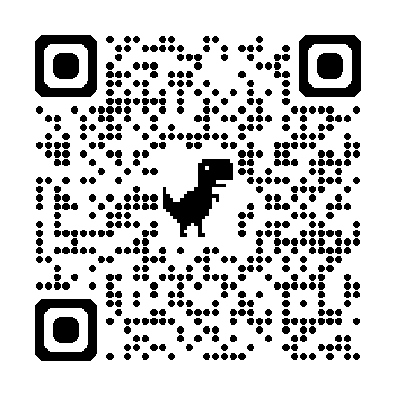
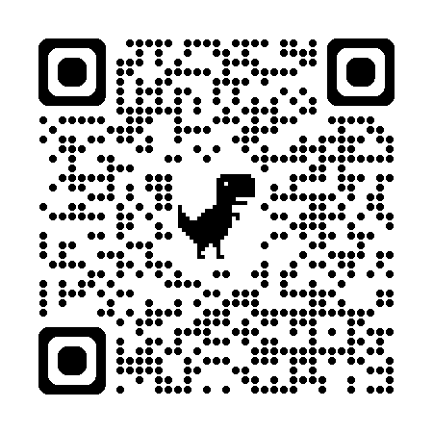
Pre-Arrival Course
Pre-Arrival Induction Course
Get Ready to Study Resource

Slide 35
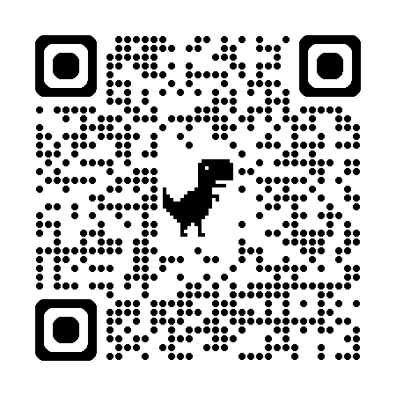
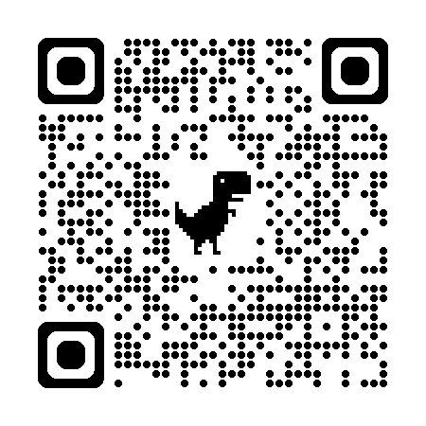
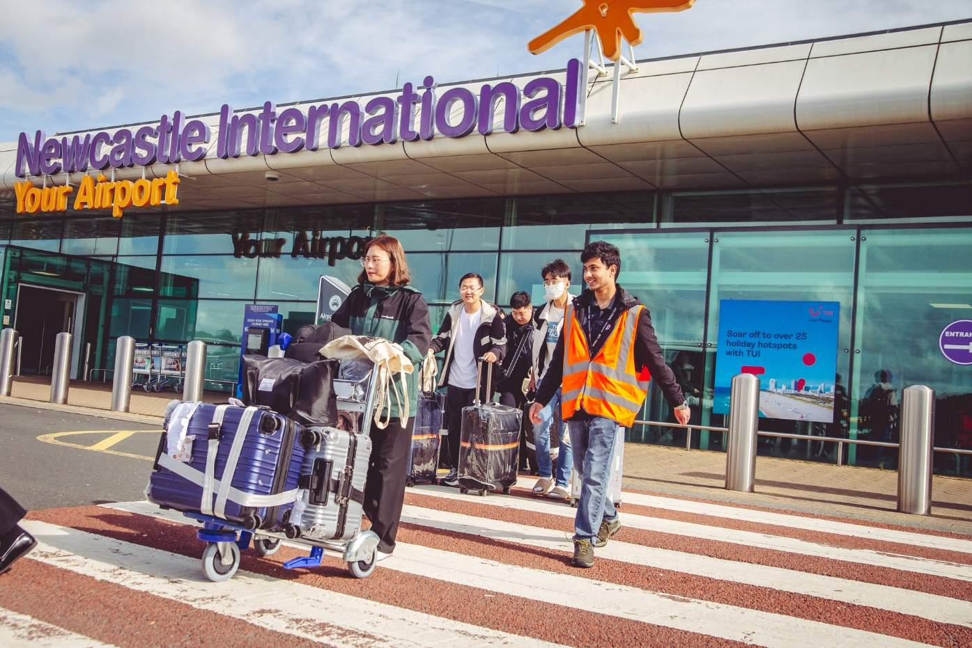
Important Events
Newcastle Airport Meet & Greet Service
15-17 September
International Welcome on Campus
16-18 September
Teaching starts Monday 28 September

Slide 36
Term Dates 2026-2027
Terms | Semesters
Autumn Term: Monday 21 September 2026 – Friday 11 December 2026 | Semester 1: Monday 21 September 2026 – Friday 22 January 2027
Winter Closure: The University will be closed from the 23 December 2026 and reopen on 4 January 2027.
Spring Term: Monday 4 January 2027 – Thursday 25 March 2027
 | Semester 2: Monday 25 January 2027 – Friday 4 June 2027 (Term dates may vary for some postgraduate courses so check with your School)
Spring Vacation: Friday 26 March 2027 – Sunday 18 April 2027
Summer Term: Monday 19 April 2027 – Friday 4 June 2027

Slide 37
Registration/ Online Registration
Start the registration process on the Student Portal, before you arrive at Newcastle.
Once you accept your unconditional offer to study at Newcastle, we'll email registration instructions to you.
Registration instructions are being sent out from August onwards!

Slide 38


Preparation
Healthcare
You will be able to access the National Health Service (NHS) during your studies in Newcastle, however you need to register with a General Practitioner (GP) clinic when you arrive before you can use the service.
There is a fee (Immigration Health Surcharge) charged per year for this service and it is compulsory for all students on the Student Route visa.
£776 per year for students
Paid fully in advance during visa application
If your visa is for more than a year, you’ll have to pay:
the yearly cost plus half the yearly cost, if it’s for 18 months or less
the cost of 2 full years, if it’s for more than 18 months but less than 2 years

Slide 39
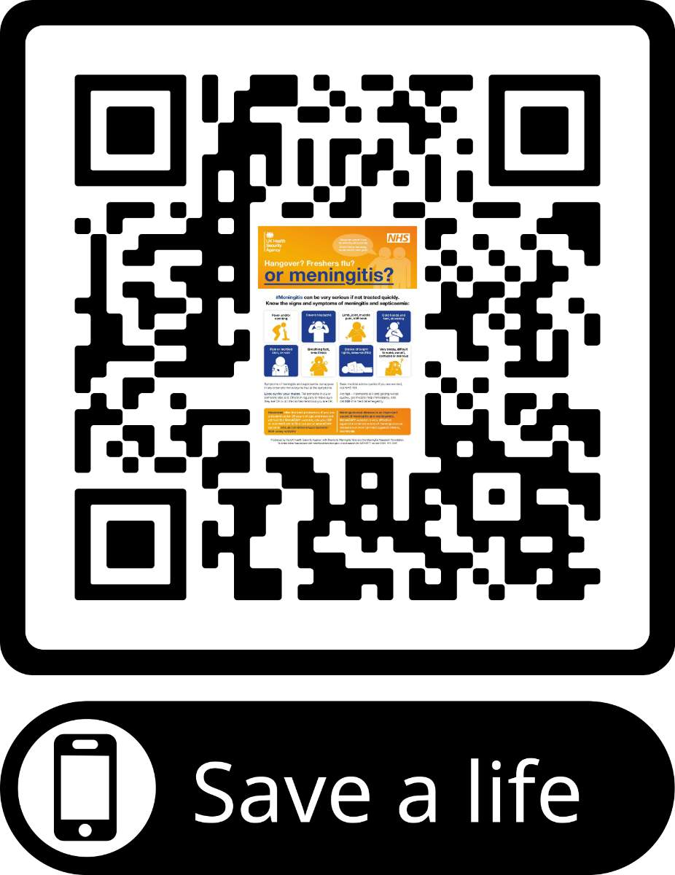
Meningococcal group B (MenB) vaccination
Meningococcal group B (MenB) bacteria can cause serious, life-threatening illnesses.
Being around lots of new people in shared living spaces like university halls increases the risk of the bacteria that cause meningococcal disease spreading.
In the UK, those aged under 25 who will be starting university for the first time in autumn 2026 as residential students are being offered vaccination against MenB.
Getting vaccinated against MenB is the best way to ensure you are protected. Ideally, you should have the vaccines you need before leaving for the UK so that you can build up protection before you arrive at University.
Whichever vaccine you have, it’s important to note the vaccine and the date you received it in your vaccination record (e.g. International Vaccination Book or vaccine record card) and bring that with you to the UK to help confirm that you are up to date.
If you are already in the UK, then depending on where you are living, you can find out more information about the MenB vaccination, and how to get it on the UK Government website – gov.uk
Check out the QR code on the right to download a symptom checker that will help you recognise what to look out for.

Slide 40
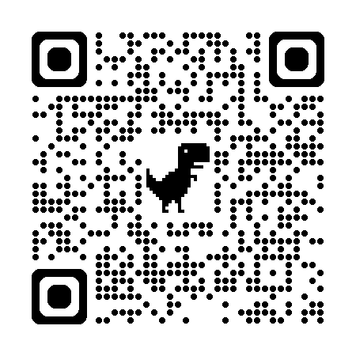
Preparation
Money
You need to have enough British currency (GBP) to cover your immediate need for travel to Newcastle and upon arrival (including emergencies)
Carrying about £300 - £500 may be sufficient if all deposits have been paid earlier
Make sure you have access to sufficient funds for the duration of your studies (the 'financial requirement' is part of the visa process)
Newcastle University is a nearly ‘cashless’ campus
For more information about your cost of living as a student, visit:
Personal items
Make sure you have some warm clothing for the initial settling in – Newcastle may be cooler than you're used to!
After that, shopping is great in Newcastle!

Slide 41
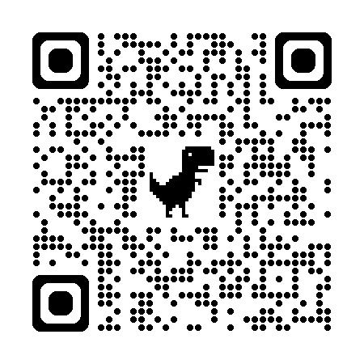
Campus Catering Deals
Preparation
We want to make sure you get the best deal whenever you make a purchase in one of our cafes on campus. Find out more about our UPAY App and how you can access exclusive discounts!
https://www.ncl.ac.uk/catering/save-money-on-campus/

Slide 42
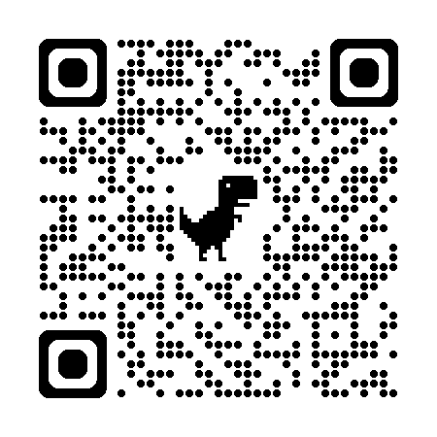
Support and Wellbeing
The Student Health and Wellbeing Services aim to help you maximise your potential whilst studying. We offer support, information, and guidance on a wide range of topics for free to current students.
https://www.ncl.ac.uk/wellbeing/

Slide 43
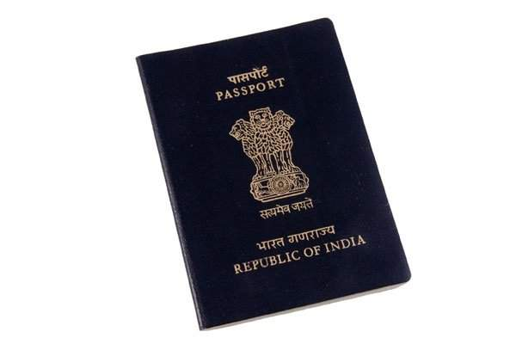
Preparation
Documents to keep in your HAND LUGGAGE
Valid passport and your eVisa (including a valid share code)
Printed copy of your UK visa decision email
Documentary evidence of funds to study (bank statement, sponsorship letter, scholarship)
Evidence of your accommodation and course (e.g. CAS, accommodation contract)
Copy of your tuberculosis testing results (recommended)
Medical/X-ray reports/Vaccination certificates or letters (if required)
Prescription medicines with supporting letter (if required)
Check your eVisa before you travel
Go to ncl.ac.uk and search eVisa

Slide 44
Checklist (pre-arrival)
Have you…
booked your accommodation? | applied and received your visa? Link eVisa to your passport? | started your registration process in the Student Portal?
booked your flight tickets, connecting flights, transfers, insurance? | checked your luggage weight and made sure you can handle it safely? | arranged airport meet and greet/transport on arrival?
checked information about how to get into your accommodation? | got all the contact details for emergencies? | obtained all necessary documents, medication, currencies?

Slide 45
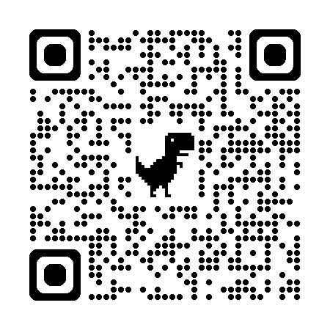
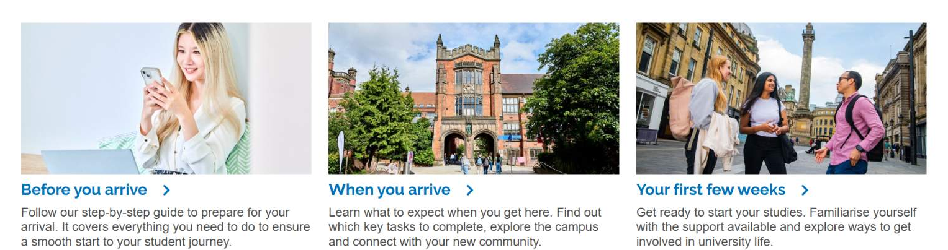
Arrival in Newcastle
Our Student Welcome webpages guide you through the process of becoming a student at Newcastle University, from before you arrive through your first few weeks.
https://www.ncl.ac.uk/student-welcome/
We also have a page of information specifically tailored for international students: https://www.ncl.ac.uk/students/communities/international-students/

Slide 46

Notes:
Introduce yourself and that you are from Newcastle University Students’ Union.
Explain that you are here to give a short presentation about the Union and the different things that we offer for students to get involved in.

Slide 47





Ran for students, by students!
More than a building; we are a community where student life happens.
Where you’ll find everything from clubs, societies and volunteering to support services, and chill spaces on campus.
There’s something for everyone and everyone is welcome!
Notes:
Newcastle University Students’ Union is the place to go for all things student life.
It’s ran by students, for students and whether you’re here to create, chill or lead on campaigns, the Students’ Union is here to connect you to hundreds of student groups, teams, projects and opportunities that will help you get the most of your university experience.
Everyone is welcome to drop by the Students’ Union at any time and have a look through what we do!

Slide 48








President
Gina Tindale
Academic Officer
Anushka Sonwane
Opportunities Officer
Kyi Nue Phyu Sin
Wellbeing & Communities Officer
Emma Monaghan
Sports Officer
Jack Bond
Student Media Officer
Trinity Eadie
Notes:
Newcastle University Students Union is ran by a team of elected Sabbatical Officers. Sabbatical Officers are full-time student representatives who focus on various aspects of student life and union operations.
These officers are responsible for advocating student interests, organising student events and managing student services. The team work collaboratively to enhance student experience, ensure student voices are heard and drive positive change within the university.
The Sabbatical Officers who have been elected this year and who will be working on their pledges on behalf of you as students are Gina Tindale, Anushka Sonwane, Kyi Nue Phyu Sin, Emma Monaghan, Jack Bond and Trinity Eadie.
You can find them on Level 1 of the Students’ Union and they are your first point of call for any issues or concerns you may have.

Slide 49

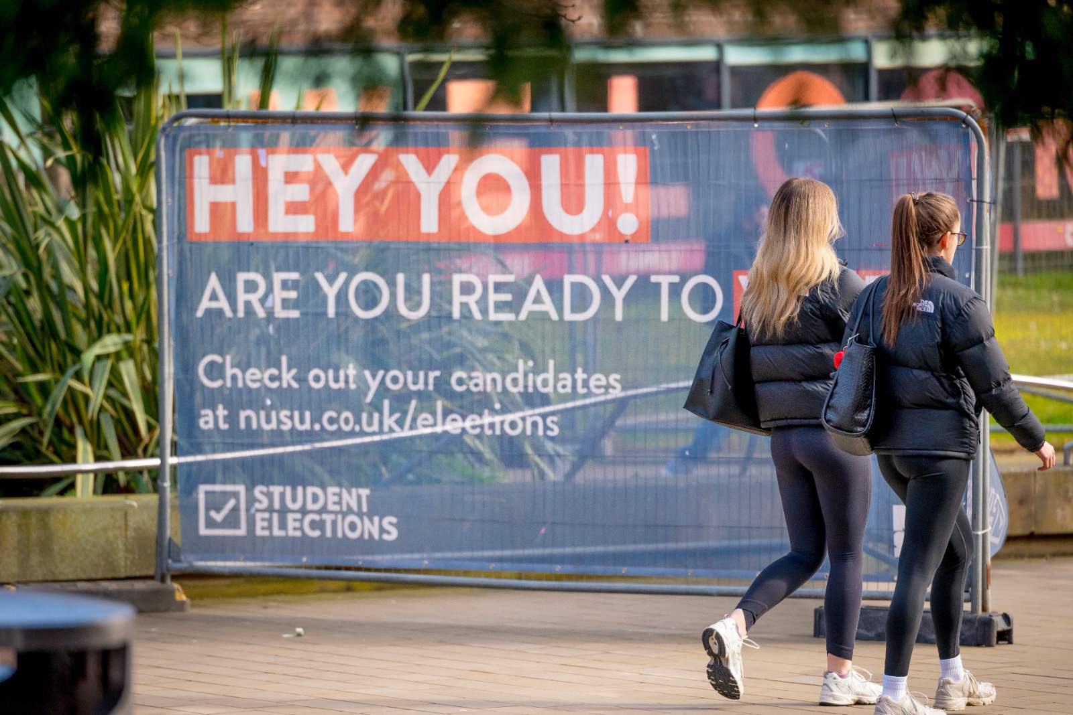
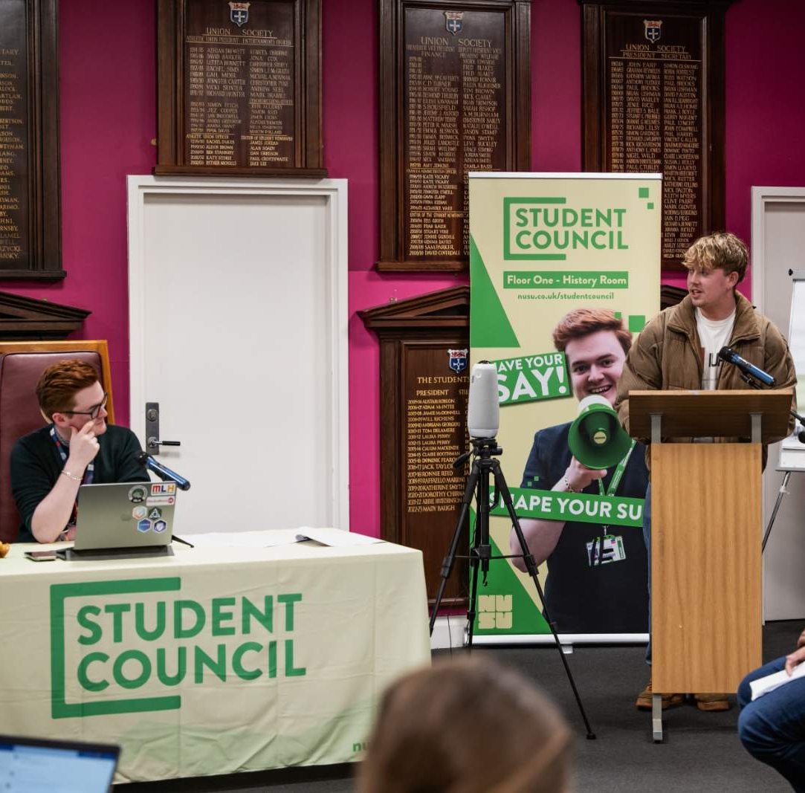
Alongside our Sabbatical Officers we also have…
Student Council
Annual Student Elections
School & Course Reps
Liberation Officers
Notes:
In terms of making student voices get heard, alongside our Sabbatical Officers, we also have a number of other ways in which we represent you.
Student Council is our primary decision-making body. It’s your chance to have a say in how things run at Newcastle University and is a democratic space where you can propose ideas, debate them and vote on issues that matter to you and your uni experience. If a motion gets passed, the Union has to act on it so your ideas can make all the difference!
We also have a school and course rep network who attend key faculty meetings as well as Student-staff committees to represent the views of students within their school or course with the aim to change and improve academic experience.
We have team of Liberation Officers. These roles act as a representative figure and voice for students of a particular community.
Our Liberation Officers are elected annually by students in our Student Elections where our Sabbatical Officers are also elected. These elections take place in February and March every year and all students are eligible to nominate themselves and vote.

Slide 50


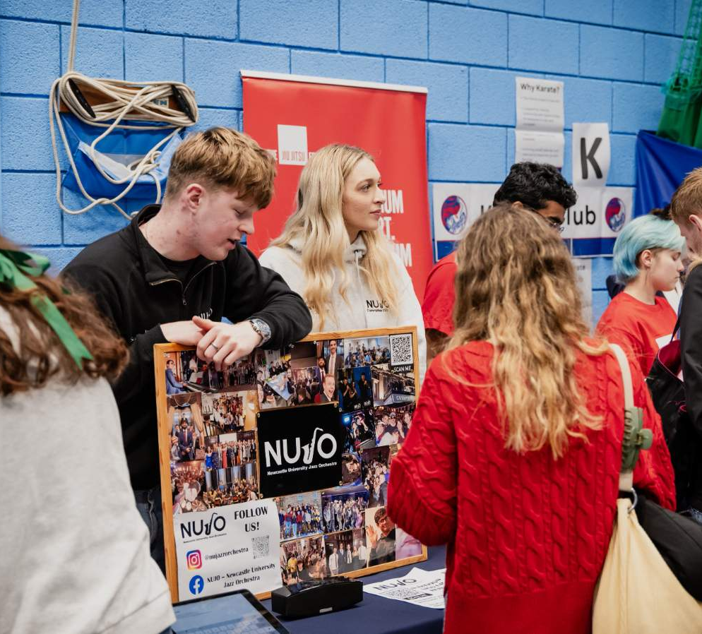
At NUSU, we have:
Over 160 societies
Over 60 clubs
Something for everyone!
Clubs and Societies are:
A great way to make friends
Easy to join or start your own
Notes:
We have over 240 clubs and societies for you to get involved in at NUSU on everything from rugby and rugby to anime and Taylor Swift.
Student societies are a great way to meet likeminded people with similar interests and hobbies to you and build your own community. We have academic societies for most disciplines and these academic societies are free to join for the first 4 weeks of term 1! Our free trials are a great way to see what you are interested in and what you want to get involved in without the commitment of a membership fee.
Similarly, clubs are a great way to meet likeminded people. They’re also a great way to continue or start your passion for sport. There are over 60 competitive sports clubs that play in our BUCS league every year.
Clubs and societies are easy to join. Memberships start from just £5 and support funds are available if needed.

Slide 51



There are a number of funds available designed to help you access Clubs & Societies. These are:
Activities Access Fund
Disability Inclusion Fund
Ethnic Diversity Fund
More info can be found on the Welfare & Support Centre page on our website.
Notes:
The support funds available are designed to help you access clubs and societies and extra curricular activities.
There are three main funds available to students, these are: the activities access fund, the disability inclusion fund and the ethnic diversity fund.
The activities access fund is available to students of all stages and is your opportunity to apply for up to £350. To be eligible for the fund, you must meet at least one point of the eligibility criteria which is available to read on our website.
The disability inclusion fund is a specific fund to help students who have physical or hidden disabilities, long-term health conditions or sensory impairment. It can be used to help with specialist equipment, specialist coaching or training and associated membership costs.
The ethnic diversity fund is another specific fund with the purpose of helping to support ethnically diverse students. The fund aims to enhance and grow activities on campus that celebrate and benefit ethnic diverse student groups, raise awareness of racial discrimination and educate our university community on different cultures, heritages and ethnicities. The ethnic diversity fund can also be used to support the cost of conferences and training to aid with personal and professional development.
More about the funds available, including the eligibility criteria, can be found on the welfare and support centre page on our website.

Slide 52

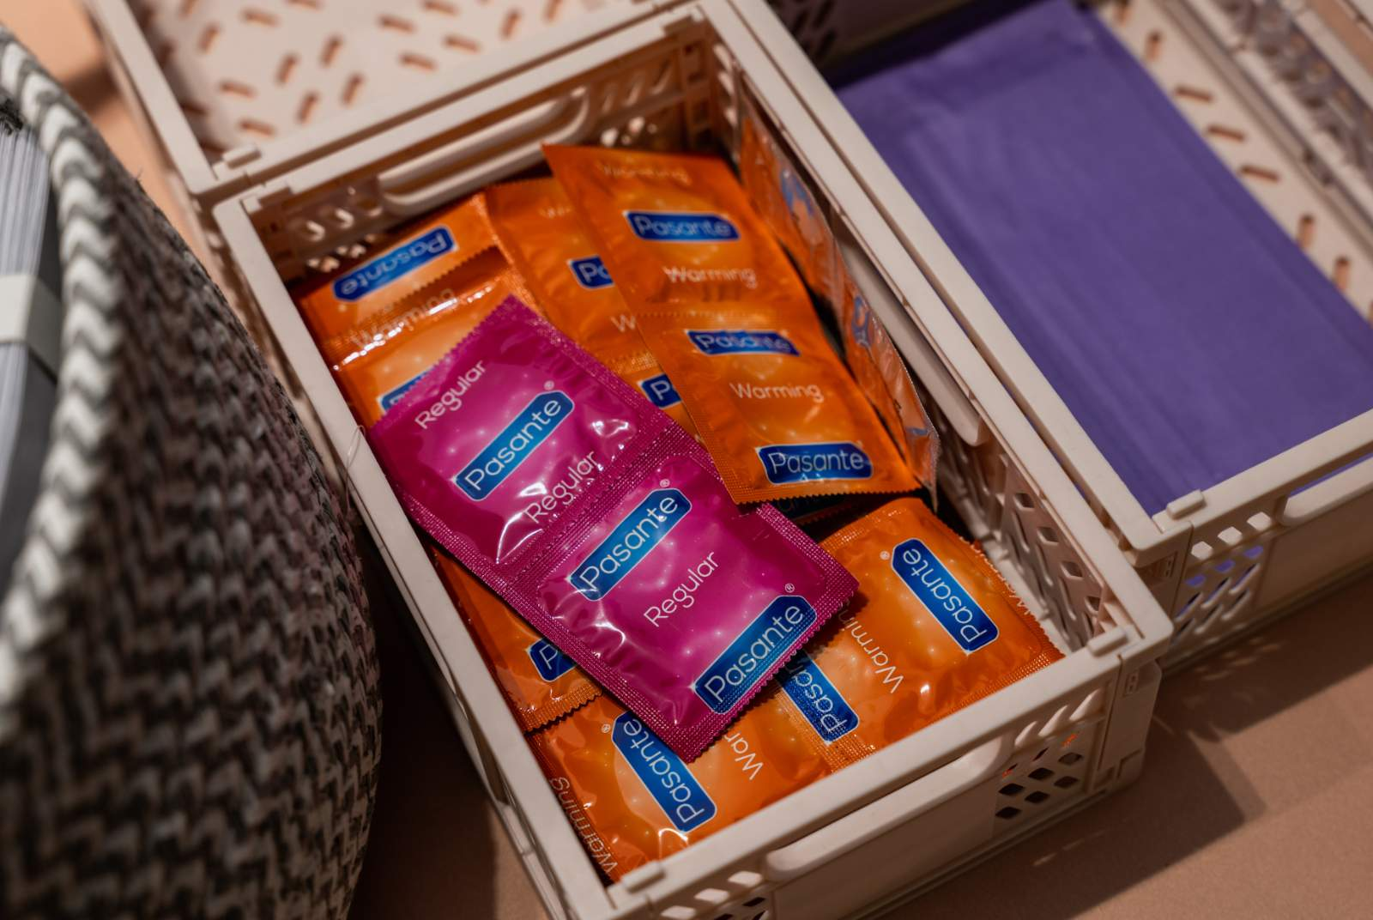
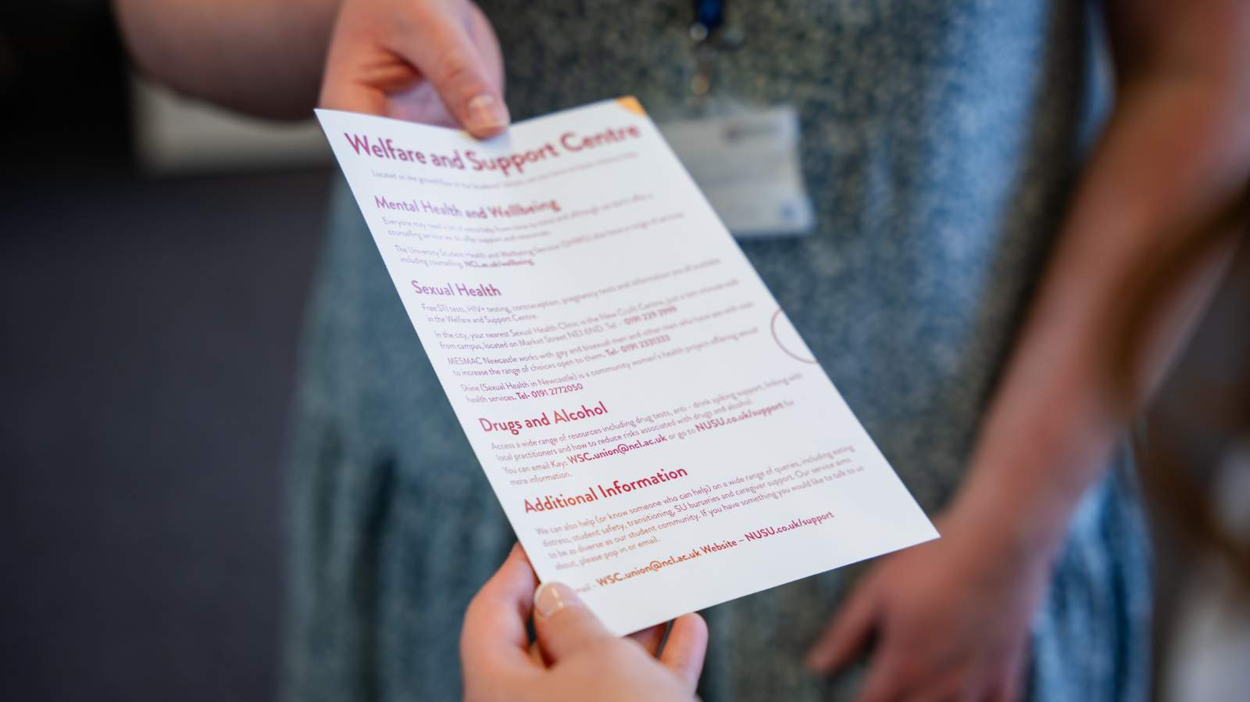
Our other support includes:
Housing advice
Academic advice
Wellbeing drop-ins
One to one advice services with trained advisors,
Free resources
Our Support Hub is a safe space for everyone and can be found on Level 0 of our SU building.
Notes:
Our support doesn’t just end at support funds.
At NUSU, we understand that studying and living a student lifestyle can affect your wellbeing and everyone may need extra support from time to time, that is why we have our support and advice hub on the ground floor of our Students’ Union building.
Here we offer everything from housing and academic advice to general mental wellbeing drop-in’s and a safe space to take a breather.
We offer one-to-one advice services with our trained advisors on an appointment only basis. This service is independent of the University so it may be an option if you would like help from another party.
As part of our support services, we also offer a huge range of free resources for our students. Including free condoms, STI testing kits, anti-spiking devices, pregnancy tests and much more.
Our support hub is free to access and a welcoming space for everyone to pop in. You can also find a full list of our online resources on our website.

Slide 53

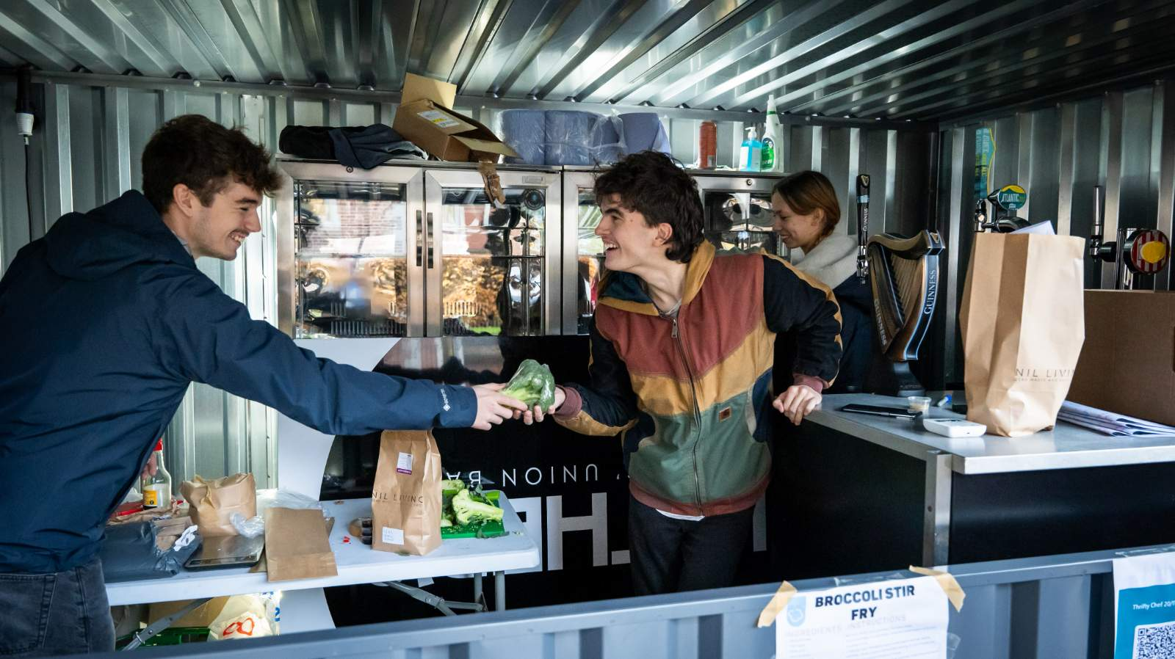
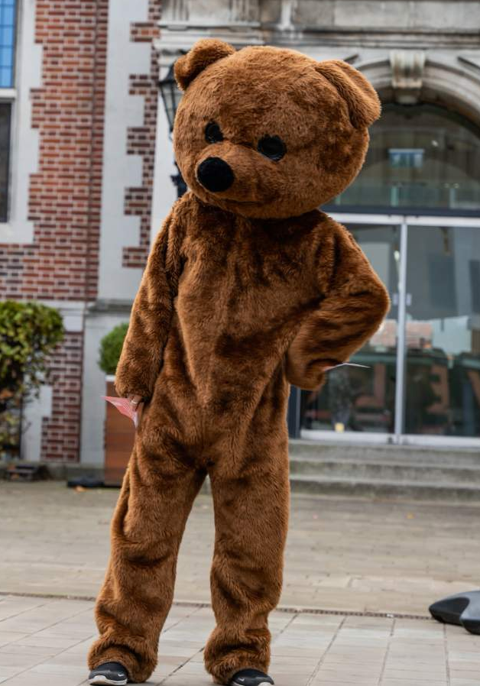

Our volunteering team offer opportunities to work with:
Over 150 charities
Local schools
Communities and voluntary groups,
You can also join Student Media where you
can get involved in:
The Courier
NSR
NUTV
Notes:
We want all of our students to take advantage of all opportunities available to them and we want to help students take on new responsibilities, develop skills and help support the local community.
Our volunteering team offer opportunities to do just that with opportunities to work with over 150 charities, schools, communities, and voluntary groups all throughout the year.
You also have the opportunity to get involved in the Student Media team where you can write for our student newspaper, The Courier, run your own radio show with NSR or film, edit, produce and present your own show on NUTV.

Slide 54
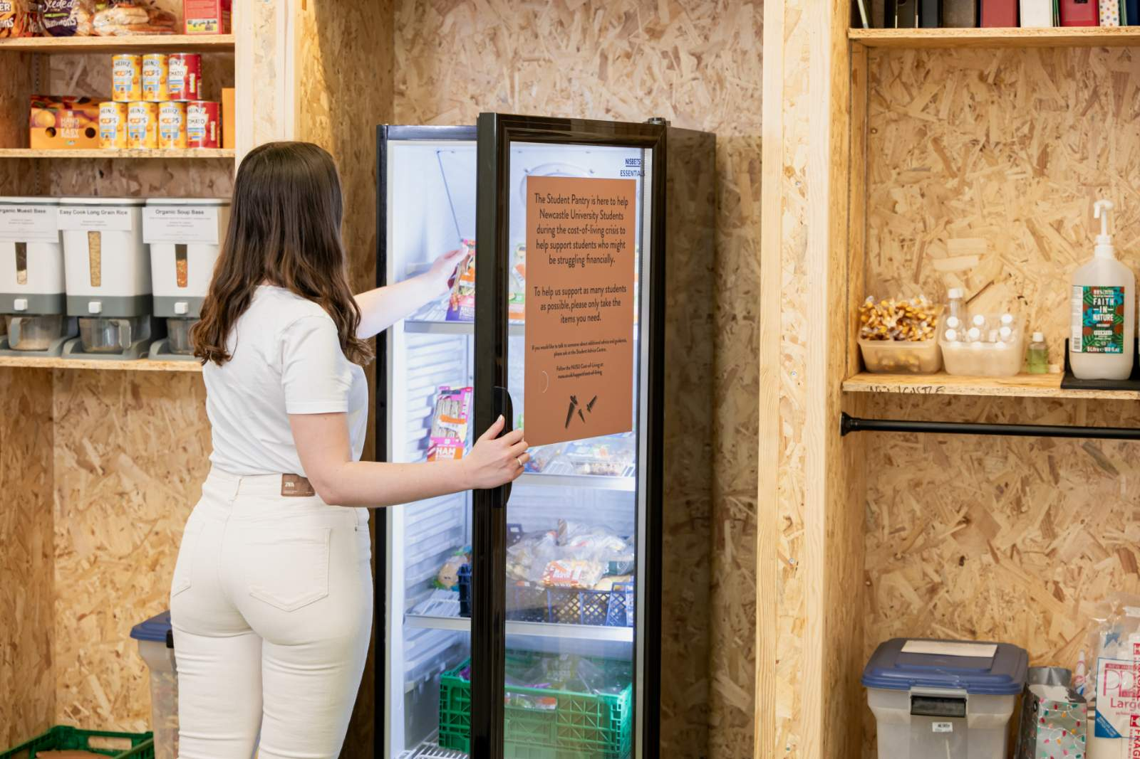


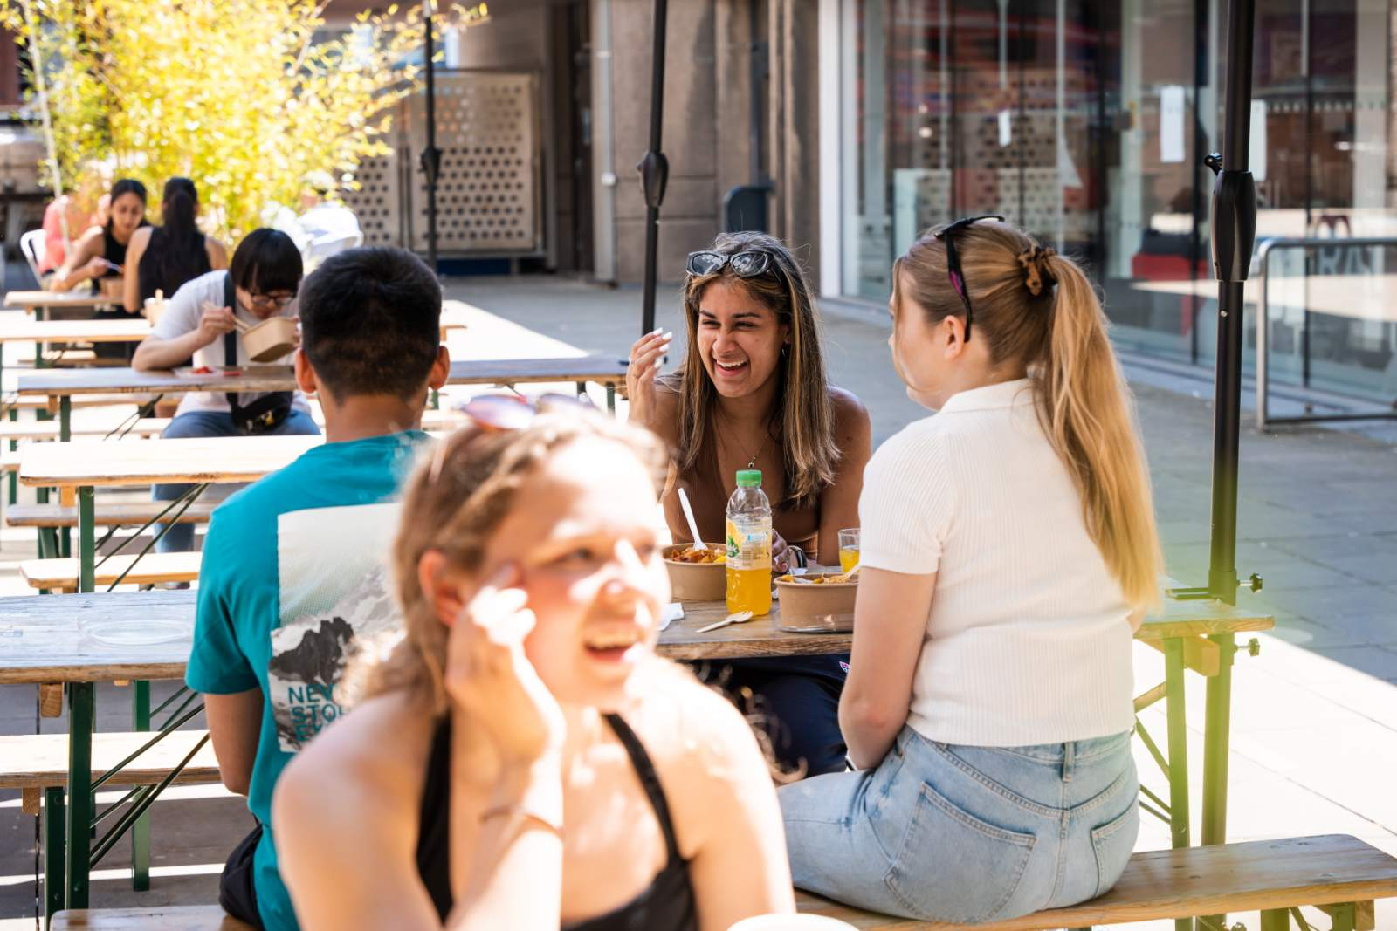

We have a range of food and drink options in our SU building, including:
Luther’s Bar, Wetherspoons
Co-Op
Kimchi Planet
Shijo
Mi Cha
Notes:
If you are looking for a place to grab lunch or just to chill out on campus, the Students’ Union is a great option.
Right in the middle of campus, we have loads of food and drink options all at student friendly prices.
Luther’s Bar, Wetherspoons is a great option for a huge range of food and drink plus daily deals and discounts like curry Wednesday’s and free refills on tea and coffee every day.
Co-op is our very own supermarket, offering everything you need for a quick snack to the ingredients for a great meal.
Shijo - a Japanese Asian street food café serving both mains and side dishes with prices starting at only £2.50. ​
​Starting out as a street food stall, Kimchi Planet is one of Newcastle’s first Korean restaurants and we are delighted that they are right in Level –1 of your Students’ Union building. ​
Mention your favourite.

Slide 55

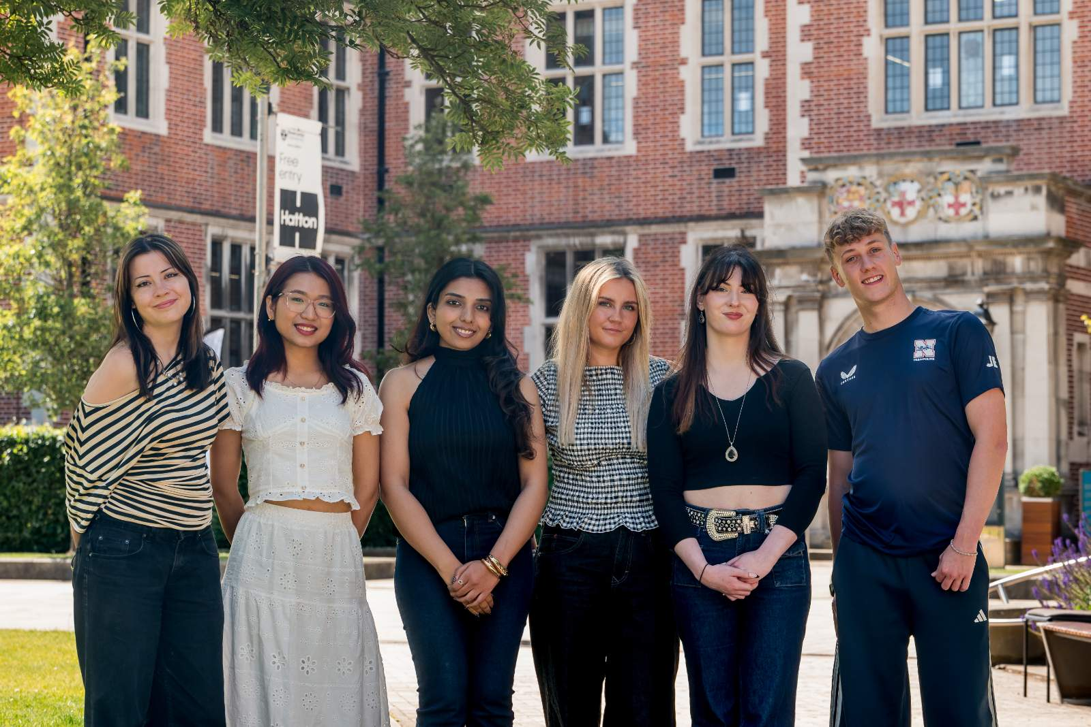
Visit Us On Campus!
Call Us: 0191 239 3900
Email Us: student.union@newcastle.ac.uk
Follow Us: @newcastlesu
Notes:
If you have any queries or questions, you can call us on 0191 239 3900 or email us at student.union@newcastle.ac.uk
Or you can drop in! We are currently going through a period of refurbishment so some of our facilities aren't accessible but you can access our Quiet Lounge on Level 0, our Co-Op store and all food and drink offerings as well. If you need to speak to any members of staff, most of us can be found over at Great North House on Sandyford Road, next to the Marjorie Robinson library.
Make sure you keep up to date with everything that we are doing on our social media @newcastlesu and visit our website at www.nusu.co.uk
Make sure you check out our Big Welcome programme, coming soon this September. This is where you'll find information about all of our upcoming fairs, activities, events and everything to help you get settled into Uni life. It's also where you'll find our visits and tours which are particularly popular. Tickets for this programme go on sale on 7 September but the programme is live on our website now.
Also make sure you check your emails every week for our weekly emails!

Slide 56
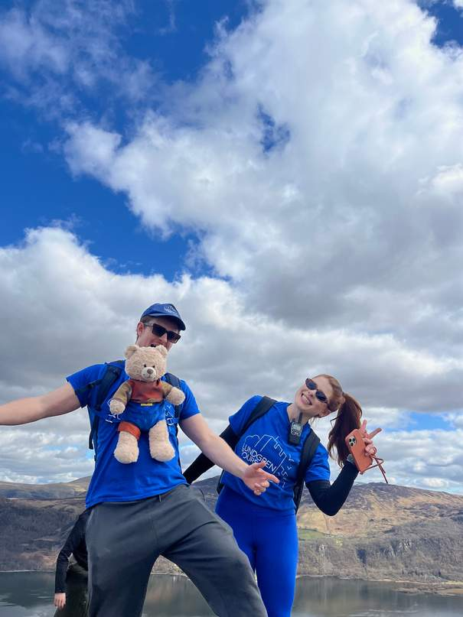


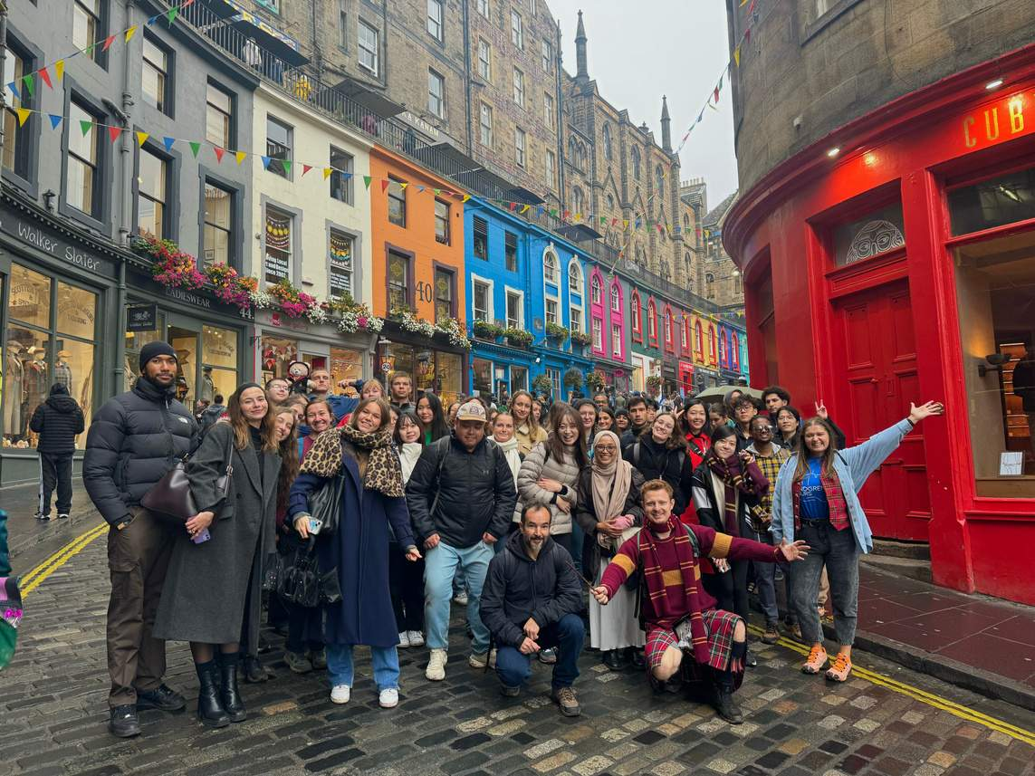










Travel the UK with Lundgren Tours
YOUR MOST FUN TRIP YET
SAT
Lake District
Sightseeing Trip
FRI
3 Day Trip to the Scottish Highlands
19
16
SEP
OCT
SAT
Edinburgh &
Arthur’s Seat
SAT
Halloween Trip to
Whitby Goth Festival
& Goathland Station
26
31
SEP
OCT
SAT
Viking Tour of Lindisfarne & Bamburgh Castle
SAT
Lake District
Sunset Trip
03
07
Oct
NOV
SUN
Harry Potter Trip to Alnwick Castle & Town
SAT
Glasgow
Scotland’s biggest city
04
14
OCT
NOV
BOOK THROUGH NUSU FOR A 10% DISCOUNT
SAT
York
Christmas Trip
21
NOV
FRI
3 Day Trip to the Scottish Highlands
SAT
Edinburgh
Christmas Trip
09
28
OCT
NOV
Visit Our Website:
Follow Us On Social Media:
For More Information:
www.lundgrentours.com
@lundgrentours
Robertjones@lundgrentours.com
+44 7926 908625

Slide 57
Why Travel With Us?
  Make friends from all over the world
  Explore the best of the UK
  Real experiences, not just typical tours
  History, culture, movies & more
  Multi-Award winning tour guide, host & performer
  Safe, friendly, and fun atmosphere
  No stress, just enjoy the journey
  Executive transport & attraction entry included
  Trips designed for international students – Great prices
  Step out of your comfort zone – In the best way
  Travellers’ Choice Award – 7 years in a row
  Support a small local family business

Slide 58





Join our International Community

Slide 59
Careers Service

Slide 60

“Why do I need to think about this now?”
It’s never too early to think about what you want to do after University and plan how to get there
The global job market is competitive – you need to stand out from the crowd
UK employers are demanding – you need to evidence additional experiences/ work experience if applying in the UK
There are lots of opportunities to gain experience and enhance your profile during your studies –we are here to help you from Day 1!

Slide 61
What does our Careers Service typically do?
CV & application support (incl. interview coaching)
Advice/info on finding jobs & work experience
Guidance on career planning
Skills development workshops
Start Up support
Employer events
Internships/work experience programmes
Bespoke support for international students
Networking opportunities
Online
in person

Slide 62


Careers Website
Information on sectors/Career Planning
Explore Occupations
Gaining experience in the UK
CV, Application, LinkedIn advice
Researching employers
Working for yourself
Volunteering
Interviews, Test and Assessment Centres
And more you can access now!
https://www.ncl.ac.uk/careers/ OR use the QR code

Slide 63

Our International Offer
Pre Departure – Access Now!
Webinars
Our website - https://www.ncl.ac.uk/careers/
Career Navigator will help you get up to speed with career planning, gaining experience, recruitment timelines and more!
Access using the link or QR code below!
https://ncl.instructure.com/courses/58977

Slide 64
Our International Offer
On Campus
International Welcome
Presence at the welcome fair and running x2 careers service information sessions in international welcome week
International Student Pathways
Contains information and activities to support your career development - all in one convenient place! Access all our pathways via MyCareer.
China Career Gateway
Our career development programme - learn more about the Chinese graduate job market & how to make effective applications in China, online job fair with Chinese employers
Asia Career Insight Series
Workshops
Monthly workshops visa team on options post –study
How to find part- time jobs for international students
Navigating the UK job market
CV writing for the Uk job market
Online Resources
Additional job search tools GoinGlobal and StudentCircus (advertises visa sponsored graduate roles)
UK Work Culture Programme
Take on a business challenge and gain insights into UK work culture
Notes:
Add in Asia Career Insight Series – South East Asia and India

Slide 65
Our International Offer
Final year and beyond..
Access to Careers Service and resources for 3 years +
International job search pages website
GoinGlobal
50+ Country guides on visa’s, job market, applications and more
China - online and in-person Fairs

Slide 66
Work experience at Newcastle University
Work opportunities on Campus
NCL internships
Unitemps - Temporary roles in e.g., administration, customer service, library assistance, event support, open days etc.
CV Advisors
Street Scientists
Exam invigilators
Student Ambassadors ...and more
Rates of pay with the university are much higher than national minimum wage (NMW)
Paid internships with Newcastle University and with local employers​
A wide range of roles from content creation and research to web development and engineering
Flexible around your timetable and available throughout the year, during term time and summer vacation​

Slide 67


Working in the UK
Work within your visa restrictions
Apply late Aug/ Sept on job websites like Reed, Indeed
Apply once a registered student for Unitemps
Workshops beginning of term 1 – how to find a part time job in the UK for international students
Read advice on our website now

Slide 68
Other ways to gain experience
Demonstration of skills and behaviours sought by employers can come from lots of places! Including;
  Your course (projects etc.)
  Part-time jobs (communication skills, time management, teamwork)
  Volunteering (various skills)
  Positions of responsibility in clubs/societies (leadership, accountability, planning)
  Industry challenges/ hackathons (working to client brief, problem solving)
  Online internships/work experience e.g., Forage, digdata, Springpod
  You don't have to do all of this! You can be selective
Notes:
Skills in parentheses – just to highlight some skills that might not be associated

Slide 69


ncl+ Employability Award
Sign up via the QR code, or through our Careers Service website ncl+ Award | Newcastle University
Undertake 40 hours of ncl+ activity this year and receive the ncl+ award. Activity includes part-time work (in and out of the university), volunteering, societies, sport, peer mentoring, student rep roles, learning languages and more.​
To receive this University Award:​
✅ Register by 31st Jan 2027​
✅ Complete Part 1 & Part 2 (online via Canvas or in person) ​
✅ Log 40 hours of activity ​
✅ Submit your written interview-style questions & Activity Log ​
✅ Receive your certificate, badge & recognition​

Slide 70

ncl+ Award Student Experience
"The ncl+ Award has been an incredibly valuable experience. It has helped me recognise and articulate my transferable skills in a structured, employer-facing way. As an international student building a career in the UK, I believe this award will significantly increase the value of my CV and strengthen future job applications." MSc Operations, Logistics and Supply Chain Management student 2026

Slide 71

Typical application timings in the UK; summer internships, placements and graduate schemes
All timings are approximate and can vary depending on industry and role or size of company

Slide 72

Meeting Employers
Lots of opportunities
Graduate Fair – 5-6 Oct
Pop ups for part-time work
Science Careers Outside the Lab
Creative Careers
Spring Graduates Fair
Employer workshops/drop ins
What’s happening in your faculty?
What’s your strategy for engaging?
Notes:
Link timings fo fairs to previous slide

Slide 73

Our top tips
Consider part-time work/ experience/ online experiences (look at Forage internships forage.com)
Start early – and be aware of application deadlines, particularly for graduate schemes
Prepare for every stage of the application process and use our support
Get involved in University life and consider gaining additional work experience during your studies
Build contacts​ and engage with employers from the start of the academic year
Apply for your National Insurance number here https://www.gov.uk/apply-national-insurance-number

Slide 74
Find out more!
Notes:
FIXED Colour section divider slide.
Edit copy as required.

Slide 75




Find out more!
Website
Instagram
X
LinkedIn
Notes:
Azerbaijan currency

Slide 76
If you have further questions:
Africa - africa.io@ncl.ac.uk
Americas - americas.io@ncl.ac.uk
Asia - asia.io@ncl.ac.uk
Central Asia - central-asia.io@ncl.ac.uk
China - china.io@ncl.ac.uk
East Asia - eastasia.io@ncl.ac.uk
Europe - europe.io@ncl.ac.uk
India - india@ncl.ac.uk
Middle East - mena@ncl.ac.uk
Russia - russia.io@ncl.ac.uk
Southeast Asia - southeastasia.io@ncl.ac.uk

Slide 77
Thank you!
Notes:
FIXED Image / Presentation title slide.
Insert title and sub-deck as required to start your presentation.
`1234567890-=qwertyuiop[]asdfghjkl;’#\zxcvbnm,./
¬!”£$%^&*()_+QWERTYUIOP{}ASDFGHJKL:@~|ZXCVBNM<>?

